Slide 1
Local Authority
Engagement–Laura@wiganarmedforceshq.org.uk
01942 821 293

Slide 2
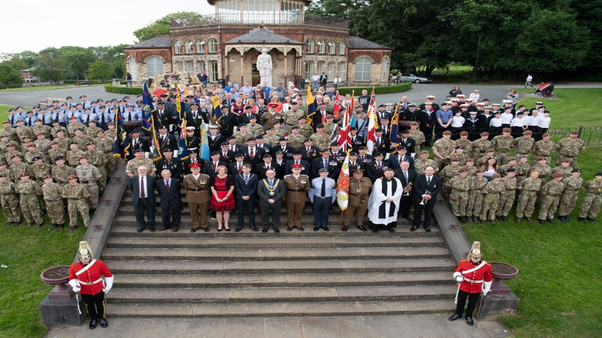

Slide 3
Background,
Complex Needs Adult Health & Social Care – Substance Misuse
Spouse of a squaddie and champion of the need to adequately support families

Slide 4
Wigan borough have a large population of Armed Service Leavers; 23,000
Commitment to support the community as a protected characteristic
Large investment into a facticity but underestimated of the how much a ‘Gold Standard’ service would cost. 150k 3 years year on a reducing budget, 22k in the final year – Sustainability (dirty word!)
Small percentage of our community identified as frequent flyers – high costs to the LA, Police, Primary & Secondary Care

Slide 5
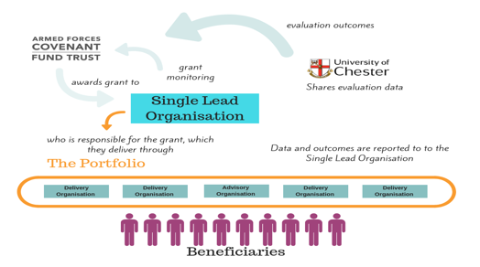
“The Armed Forces Covenant Fund Trust commissioned a £4 million programme of funding for innovative and new ways of working to reduce serious stress in veterans, carers and families”
Small number of projects to enable charities and health professionals to work together, develop and try new ideas that they have developed with veterans and their carers and families.
Wigan Council became the Single Lead Organisations (SLO) for the Unite, Inspire, Achieve Programme.
What did we learn? What did we spend?

Slide 6
Intervention Menu
Physical Health & Well-Being | Emotional Health (Feeling) | Personal Growth (Being)
Fitness & Nutrition (walking, climbing, swimming ETC) Fishing Mindfulness Outdoor Education/Nature Challenges | Stress Management Anger Management Grief Domestic Violence Parenting Confidence Building Brief Interventions (PHO) | Careers Advice & Guidance Peer Mentoring Education, Training & Employment Volunteering Hobbies/Spiritual Growth Clubs & Groups
Mental Health (Thinking) | Social Health (Relating) | Welfare
Advanced Mediation CBT/NLP/Mapping Personal Safety Mutual Aid Risk Management Online Support/self help Health Advocacy | Days Out Respite Café Social Events Open Days Team Building Retreats | Housing Welfare & Benefits Social Care Offending Complex Dependency Legal/Financial Support Bespoke Interventions (Rehab etc)

Slide 9
Social Value
Mental Health Therapeutic Interventions/Modalities (Person Centered Counselling, EMDR & CBT) | £331,870 (£4,741 cost saving per individual) | Reduced waiting times for IAPT services and improved engagement 60% reduction in crisis presentations with MH Urgent Care including A&E
Suicide Prevention Intervention | The Estimated Cost of a Suicide is 1.7Million | We evidenced the prevention of 34 Veteran Suicide attempts via crisis interventions
Housing | £91,890 (£9,189 cost saving per individual) | We have housed 10 rough sleepers
Substance Misuse | £29,505 OCU (£4,215 PP) £41,400 Alcohol (£1,656 PP) | 25 Alcohol Clients and 7 Opiate & Crack Clients have been supported in the last 18 months
Offending/Criminal Justice | £311,792 (£38,974 PP recalled) | Beneficiaries referred to reduce re-offending have been crime free since engaging with the HQ
Entering Employment | £217,000 (£18,084 PP employed) | Beneficiaries enter full time employment escaping welfare
Prevention of further Domestic Abuse | £74,745 (£6,795 per victim) | Victims of DA survivors while also supporting perpetrator with specific therapeutic interventions
TOTAL | £1,098,202.00 | For every £1 of CIF funding this year there has been a return of £51.60

Slide 10
A few more facts & figures…
55% of all clients accessed a structured intervention for housing support. 60% have been supported to move into council/private rented property 20% were homeless. 20% in our properties.
25% of clients accessing a structured intervention are using substances harmfully and are not engaged in the commissioned drug & alcohol service offer due to stigma, predominantly alcohol and misuse/overuse of prescription (legal or illicit) drugs to self medicate.
Severe Loneliness is a huge issue in the Armed Forces Community not just in our elderly cohort. The HQs breakfast clubs, host of diversionary activities, peer led support and mutual aid groups bring communities together. We regularly see over 200 people per week and 59 of our members state the HQ is their only source of social interaction.
Severe Loneliness: £9,900
We have saved £584,100 (Analysis - Department of Digital, Culture, Media & Sports June 17th 2020)

Slide 11
So what…….
April 2021 - TSS Grant ended and the LA wanted to retain the Gold Standard Service that cost 240k for 50k contribution
What!!!!!!!!!
What's THE DEAL?
How can the LA support our organisation to turn a surplus and become sustainable?

Slide 12
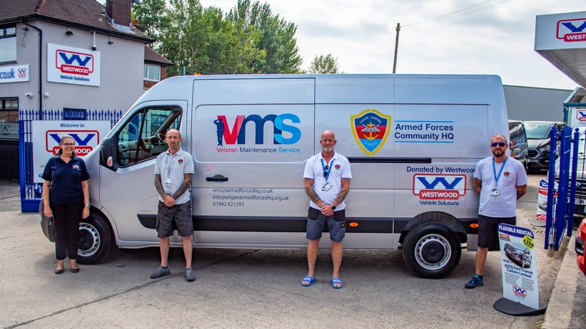
Veterans Maintenance Service

Slide 13
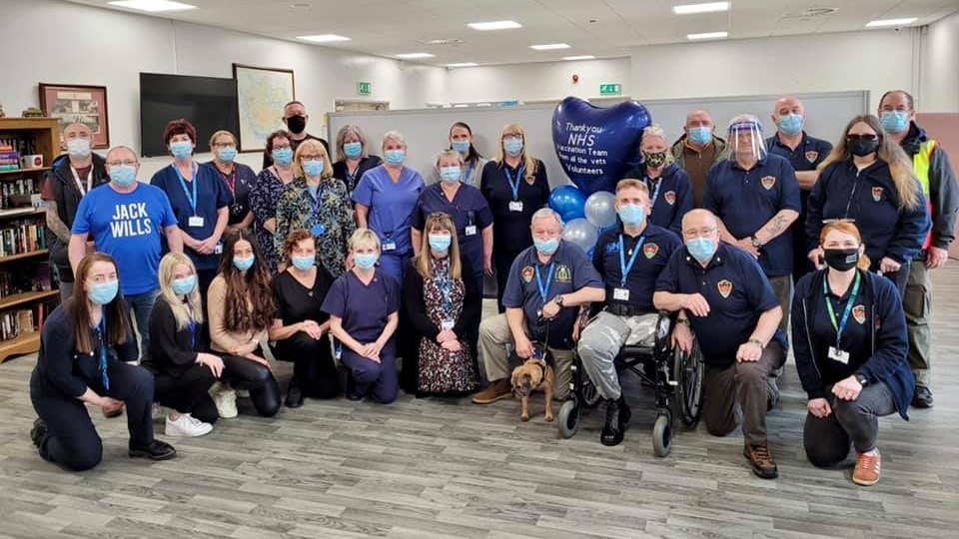
Room/Facility Hire

Slide 14
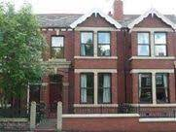
Supported Housing

Slide 15
Donations, Fundraising & Corporate Events

Slide 16
North West Consultation
Karen Miller
(Broughton House)
Laura Ingham
(Armed Forces Community HQ)

Slide 17
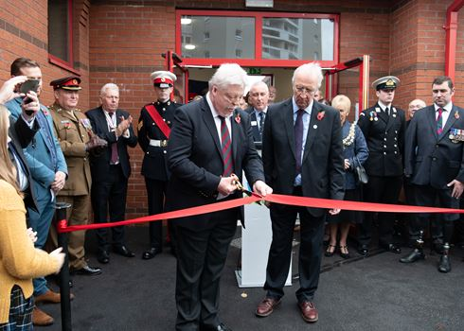

Slide 19
What we thing we can deliver…

Slide 20
Final Thoughts, Asks……….
Please consult with us – VPPP Networks across the country, we have great things to share.
Commissioners please think about who may actually be delivering services at the coal face and hold larger charity's accountable for passing the book and referring on to local providers with no renumeration.
Help us plan for the future with early release of specifications, relationships take time to build
Local delivery works

