Slide 1
Eyes and ears that give a voice to Veterans
Lt Col JG Lighten MA MBE
SO1 CI HQ 1XX

Slide 2
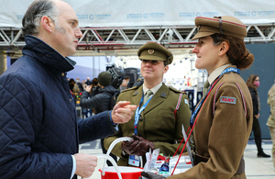

Slide 3
Independent free voice
13 Regions across the UK and ROI
Formed as war pensions committees after WW1
Reforemed in 2010
New ToRS 2021
Typical committee NW

Slide 4
NW
Set up by sub region and sector
Members of the VAPC are all well connected within their own areas and fields, and this could be with local or national governments, third sector organisations, health, education or social departments, for example. Our shared aim unifying desire is to monitor and help the needs of the veterans’ community.
National sub committes such as health and well being, crimanl justice
VPPP

Slide 5
New VAPC Terms of Reference will assist all veterans and their families
The Minister for Defence People and Veterans, Leo Docherty, endorsed the VAPCs' new supplementary Terms of Reference, enabling VAPC members to represent all veterans and their families in their region.

Slide 6
The New TORs have 2 principal purposes:
To set out the activities that members of VAPCs, as individuals and as members of informal regional groups, are asked to carry out relating to all veterans and their families.
To provide direction relating to their performance for an initial period of 12 months beginning from the date these TORs are agreed.

Slide 7
I look forward to reading your first report in May 2022 and again in November 2022 after which, further discussion can take place regarding potentially formalising your broader role in Statute. I am pleased to say that I have now signed your new TORs and a copy of these are enclosed.

