Slide 1

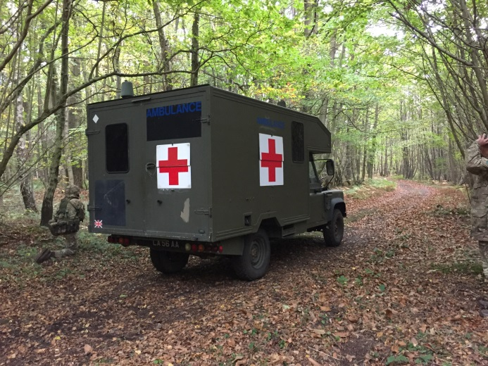



Integrated Care:
Armed Forces Network
Armed Forces Networks
www.sussexarmedforcesnetwork.nhs.uk
Afn.admin@nhs.net
Contains public sector information licensed under the open Government Licence v3.0

Slide 2
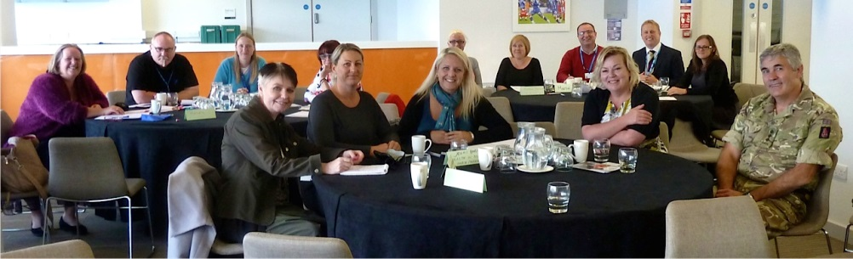
NHS Armed Forces Network
(Sussex, Kent and Medway)
It is a multi-organisational group which includes members from the:
  NHS, MoD, Armed Forces Reservists, Mental and Physical Health Clinicians, the Royal British Legion, SSAFA and other interested charities and organisations from across the counties (i.e. police and local authorities).
Service Champions
Multi-disciplinary working
Members of the AFC
  Breakfast clubs, drop-ins

Slide 3

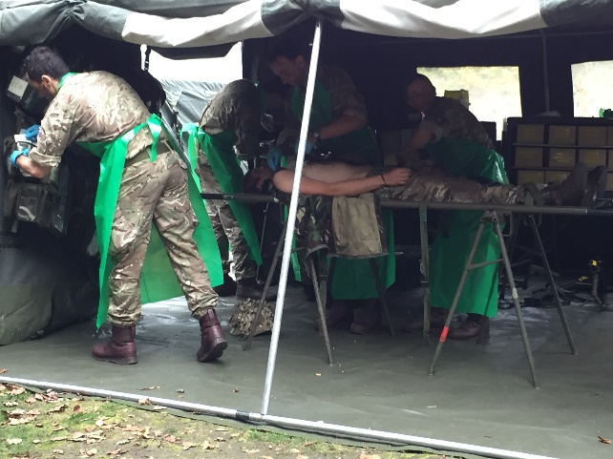

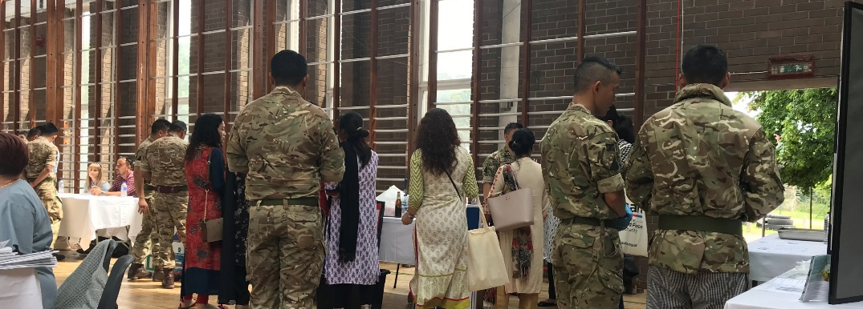
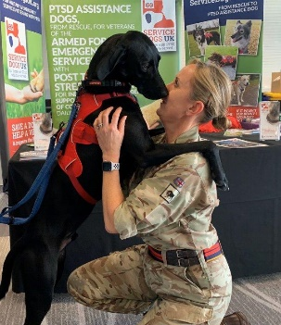
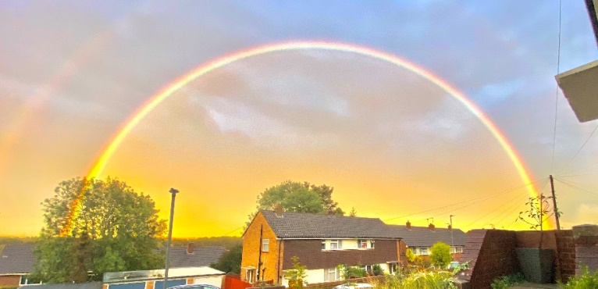
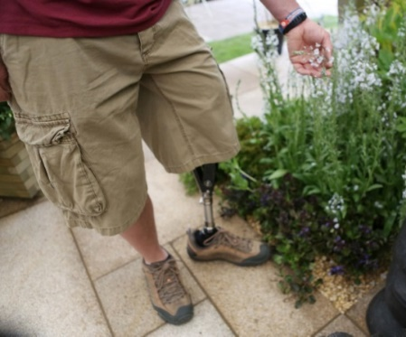
The Armed Forces Community

Slide 5

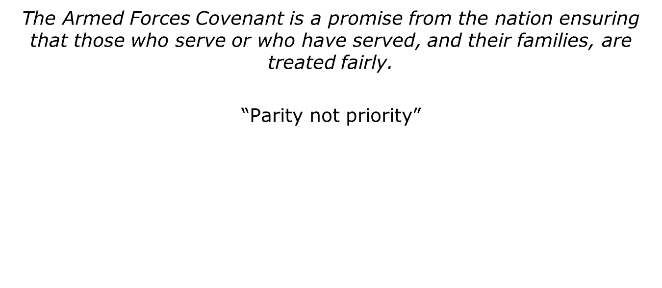

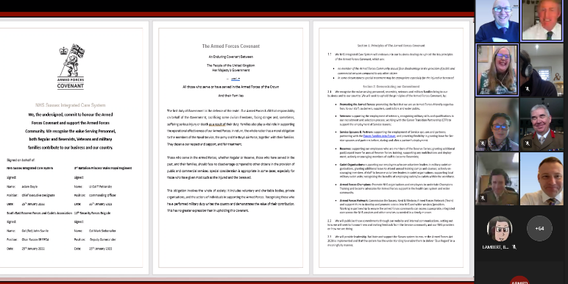
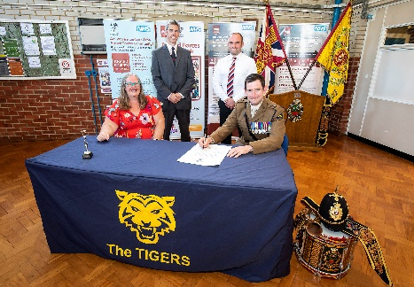
Our obligations…
The Armed Forces Covenant
Legislation
Armed Forces Act – 2011+2021
  ’Due Regard’
Health and Social Care Act 2012
Homelessness Reduction Act 2017
NHS Constitution – July 2015
NHS Contract
Care Act - 2015
Evidence Base
Joint Strategic Needs Assessments
Veterans/AFC feedback, events
Reports, Research and reviews
Health Inequalities
No Disadvantage
re-signing Covenant pledges

Slide 7


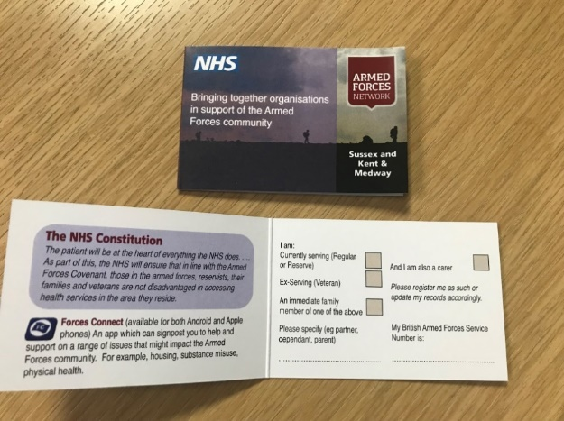



Accreditations
You may see or need to raise awareness of:
I am from the AFC Card
Do you know the status of your own GP Practice?
Tell them if from AFC

Slide 8
Actions for all
Why – Better Outcomes
Safer Care
  Access to previous history,
  Notes – Do you have all of them
  Understanding of culture, possible conditions
  Impact to family
Access to Services
  NHS Armed Forces Specific Appropriate Referral (Wording)
Wider Support for individual and family
Train Staff to:
  Ask the Question
  Record the data
  Book appropriately
  Treat with knowledge
  Use Resources
  Refer Appropriately
‘Are you or have you or any member of your immediate family ever served in the Armed Forces.’
Notes:
Referrals for Former Service Personnel’
“As this patient is a Military Veteran and his / her current condition may be related to Military service this referral should be considered for priority treatment under the rules set out in the Commissioning Board Mandate, NHS Constitution and Armed Forces Covenant”
Referrals for Reservists
“As this patient is a current Reservist and his / her current condition is affecting his / her capacity to undertake Military service, this referral should be considered for priority treatment and/or with an understanding of the higher fitness levels under the rules set out in the Commissioning Board Mandate, NHS Constitution and Armed Forces Covenant”
Referrals for Spouse or Family
“As this patient is the spouse/child of currently serving military personnel his (or her) current condition should be considered for priority treatment under the rules set out in the Commissioning Board Mandate, NHS Constitution and Armed Forces Covenant. Due to the moving of the family they should not be disadvantaged.”

Slide 9


Accessing Health- Single Point of Contact
SPOC – Pathfinders
Sussex, Kent and Medway ICBs
NHS North Yorkshire CCG
Herts & West Essex ICS
Qualification for priority healthcare
Waiting lists (Families/Deployments)
Reservists (Deployments/fitness levels)
Different conflicts will have different impacts, radiation, burns,
Diversity – LGBT+, Nepalese, women, children, families
Increased occurrence of certain ailments,
Environmental impact, - asbestos exposure, chemical, dust
Access to screening programmes (moving round, not signing with GP)
Veterans Trauma Network
(Any physical health related to serving)
OpCourage – Veterans Mental Health Service
(Any mental health)

Slide 10
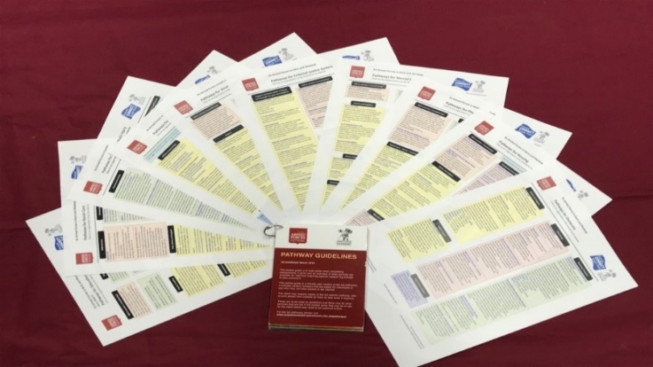



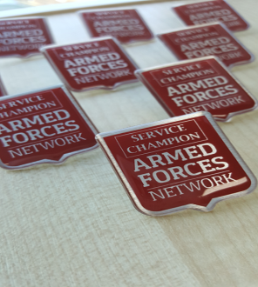
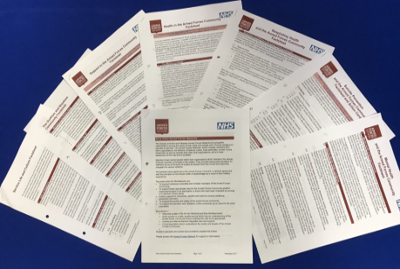
Resources
Single Point of Contact
afn.admin@nhs.net @SussexAFN
www.sussexarmedforcesnetwork.nhs.uk
Network Provide:
Training including
  Service Champions
  Mental Health,
  Suicide Prevention
  Awareness Training
Fact Sheets and Cases Studies
Gurkha/Nepalese material
Website, eLearning, Reports
Pathways
Flip Tools

Slide 11

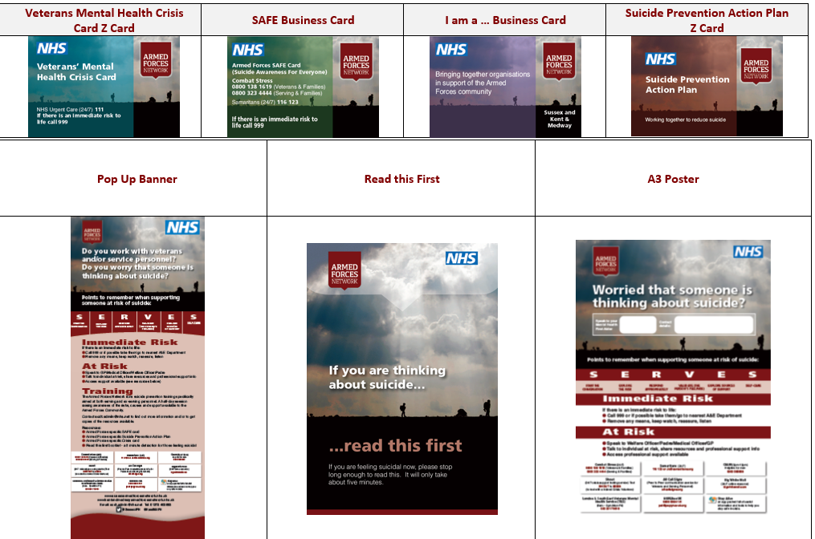


Suicide Prevention:
Train the Trainer & Resources

Slide 12
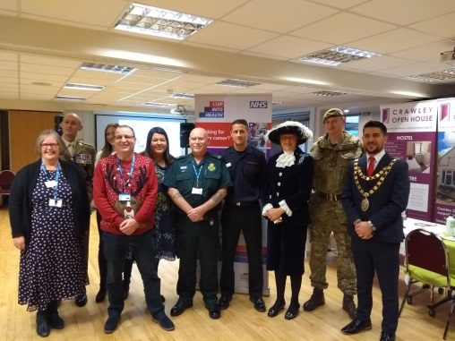
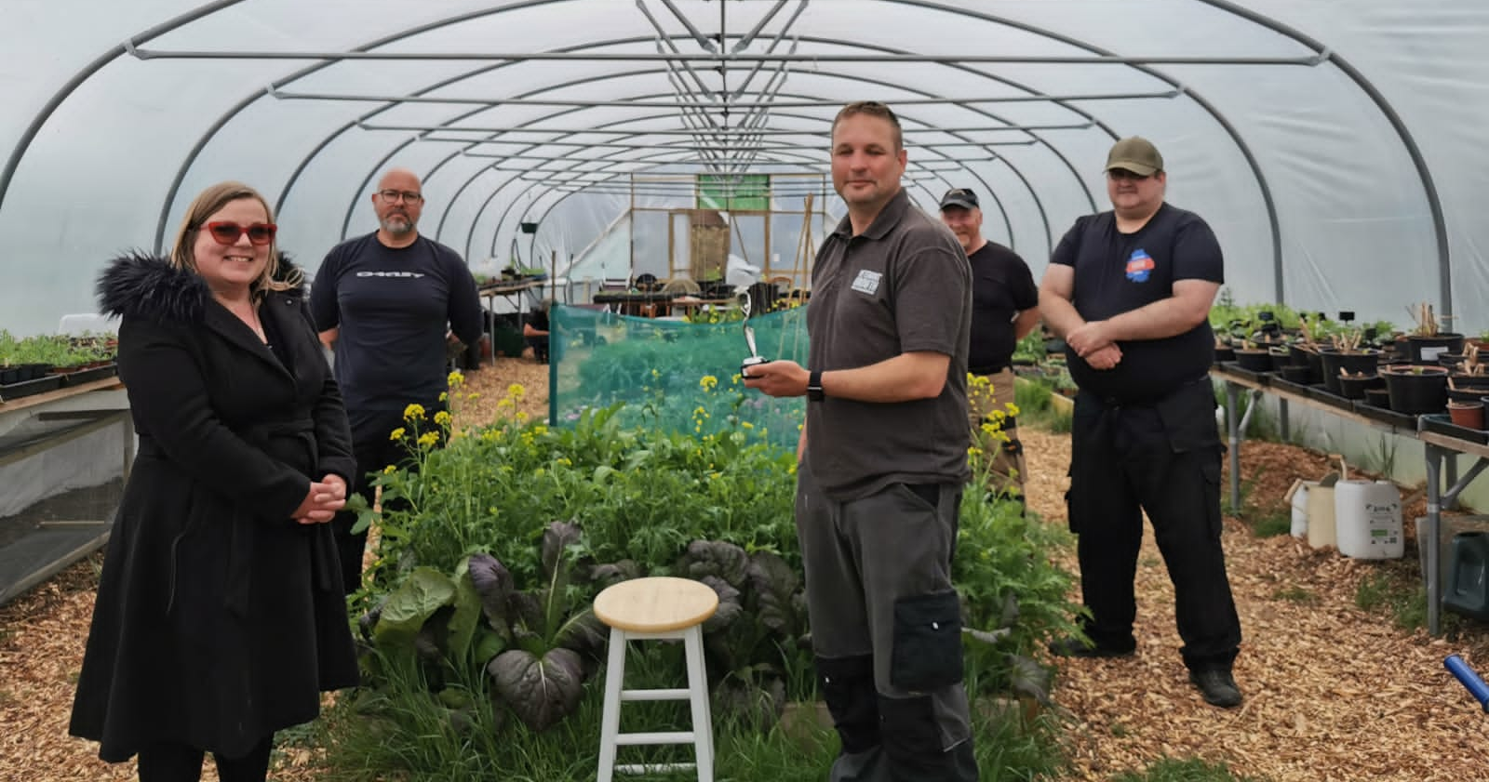
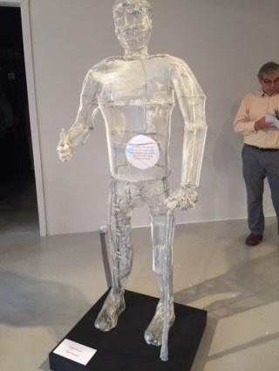
Comradeship and Activities
Befriending, Peer Support
Veterans projects in Football clubs
Drop-Ins
  www.asdic.org.uk
Breakfast Clubs
  www.afvbc.net
  www.afvbc.com
Social Prescribing
Activities
  Art, horticulture, boxing etc.

Slide 14














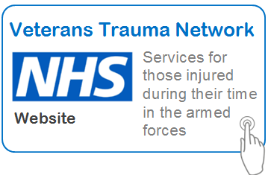















Charities and Services

Slide 15
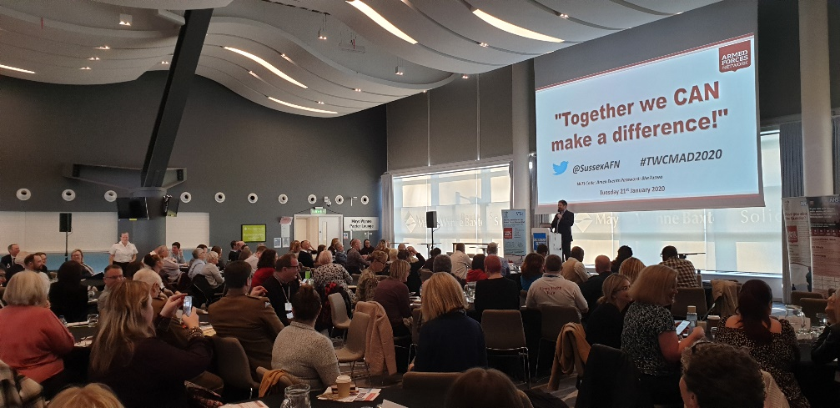
Any Questions ?
Together we CAN make a Difference
Learn, adapt and implement
Consider everyone and make that difference
Kate Parkin - kate.parkin@nhs.net or Armed Forces Network at email: afn.admin@nhs.net www.sussexarmedforcesnetwork.nhs.uk @SussexAFN 01273 403693

