Slide 1
East Sussex Veterans’ Hub and Drop In
Customer Focused
Presentation to
ASDIC Conference
Leeds May 2022

Slide 2
About ESVH - Progress
Formed 99/100 Group – Focused Cohort
2017 Offices co located with East Sussex Recovery Alliance, Central Hastings
2019 Established weekly Drop In for whole Military Community in Central Hastings
Joint contract with ESRA/ESCC addressing alcohol & substance misuse impact
on veterans
Given Charity Status and Full Membership of COBSEO
2020 Secured 2nd ESCC contract to address veteran alcohol and substance (<24 months)
2021 Secured ESCC contracts to:
Introduce Thrive Inside meditation programme
Introduction of computerised management system ‘In Form’
Organise digital communications for veterans
Run a community and Prison in Reach programme for those
challenged by opiate and crack cocaine misuse from Hastings & St Leonards on Sea
Develop Rural Facility
Reg CIO 1183583

Slide 3
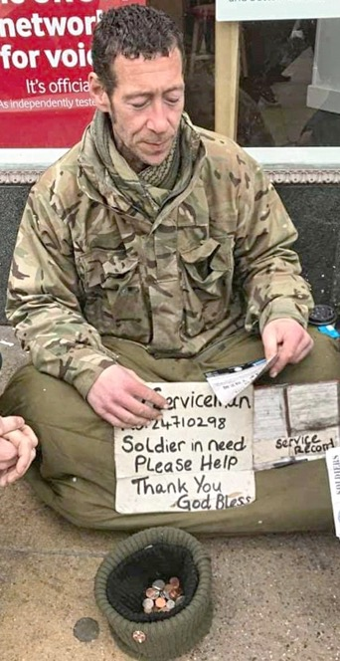
SUPPORT IN TRANSITION
Homelessness
Addiction incl.
Substance &
Alcohol Misuse
Service in HM Forces
PTSD & Mental Ill Health
Involvement in
Criminal Justice System
Domestic/Family Issues
Unemployment

Slide 4
METHODOLOGY
2022
Weekly Drop In – Veterans & Families
Information, Advice & Guidance
Volunteer Opportunities
One to One support where appropriate
Mentoring
Meditation
Fortnightly Wellbeing & Coping Sessions
Rural Activities & Camping
Sculpture & Woodcarving Courses
Modelmaking
Fishing
Photography
Families Day & Visits
Direct Involvement with Broader Community

Slide 5
Military
Charities
GPs
ASDIC
Weekly
Drop In
99/
100
Group
RECOVERY
PATHWAY
SELF
RESETTLE
Resilience
Peer Group
Leaders
Employment
Monitoring
&
Mentoring
Welfare
Wellbeing
& Coping
Assessment
TRIM
Engagement
IAG
Collaboration

Slide 6
OUTCOMES
Trauma Informed Support
Psychologically Informed Environments
People Orientated Culture
Enhanced Self Esteem
Optimism & Ambition
Regenerated Values
Resilience
New Experiences
Improved Awareness & Coping
Social Intercourse
Health
Benefits & Allowances
New Friends
Ongoing Seamless Support
Single Point of Contact
FUN!
Quality of Life

Slide 7
Examples of Outcomes
Supported veterans following suicide attempts, help others with ideation
Supported veterans to employment & volunteering.
Maintained face to face intervention for most vulberable
One veteran rebuilt his marriage, two are planning their weddings, after covid
Three veterans died, supported families and in one case arranged funeral.
Saved personal belongings when two members were returned to custody
Provided support throughout Covid, initiated a weekly newsletter, delivered food and activity parcels
Improved collaboration with community charities and statutory bodies
Introduced creative activities, sculpture, woodcarving, photography, model making.
Participation grown from 8 to over 80 during period

Slide 8
ESVH Core Messages
ESVH are here……………..
ESVH services are open ended…….
ESVH will address gaps and barriers…..
ESVH offer PoC for other organisations……………
ESVH priority is veterans, not the organisation………..
ESVH will strive to work with, in and for the broader community, to enhance transition
ESVH thank the following for their support over the years.
The Silver Lady Fund, ESCC, Covenant Fund, ES Community Fund, Hastings Lions, SENLAC Rotary, Bexhill Rotary, Black Horse, Lewes, Cranbrook ACC, HSLVA, HVA, ESCC and individual donations.

Slide 9
Working With & In The Community
Care Navigation
Outreach
Prison in Reach
Recovery Initiative
Rural Activities Facility
ESVH/ADDER Centre
Hastings

Slide 10
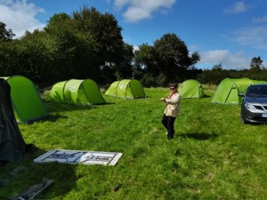
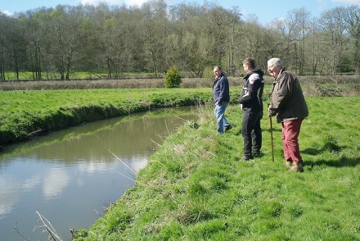
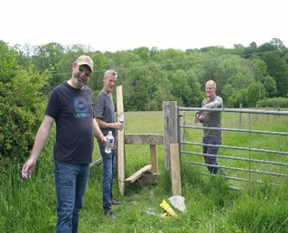
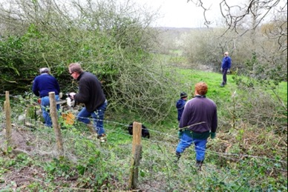
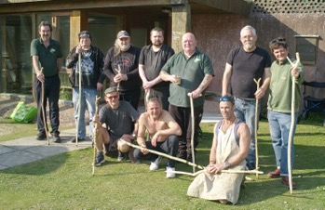
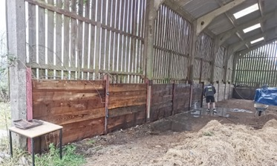
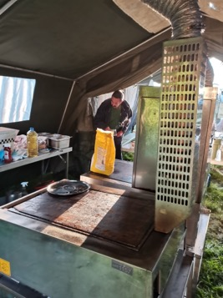
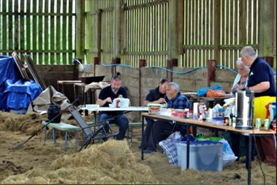
Recovery Initiative – Rural Activity Facility

Slide 11
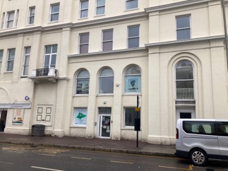
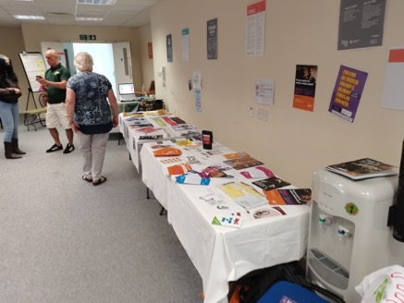
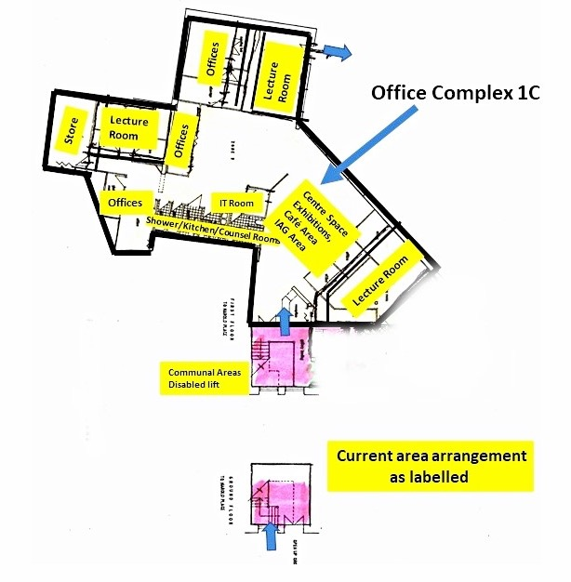
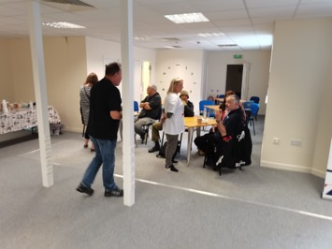
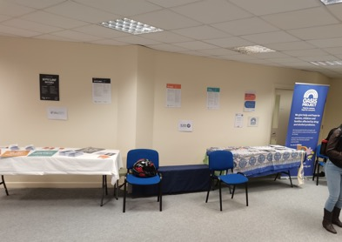
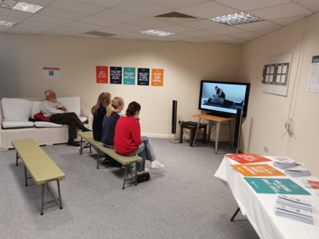
ESVH/ADDER Centre
Refreshment
Area
Establishes an ESVH/ADDER Hub
Central Location in Hastings, with Easy Access
Direct Support for any partners
Range of associated services low/no cost
Facility for new initiatives & activities

Slide 12
Thank You

