Slide 1
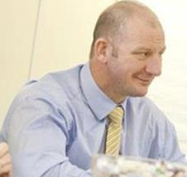
Clive Hamilton Vice Chair to the Board of Trustee`s
Thoughts From Business
Notes:
Good afternoon and welcome to the ASDIC Conference.
Firstly, thank you to the Organisers of the conference for the invitation for me to be able to share my thoughts from a business perspective.
Secondly, after the past couple of years through the pandemic, it really is so nice to see so many people coming together for what is a united goal! To support our Veteran community..

Slide 2
Points of Interest
My Background
How I got into Business
Drivers in Supporting Armed Forces
Why Woody`s
Notes:
I have put together a small agenda to keep me on track and to be as quick as possible hopefully to help understand who I am and why I want to be involved with an organisation such as Woody`s Lodge

Slide 3
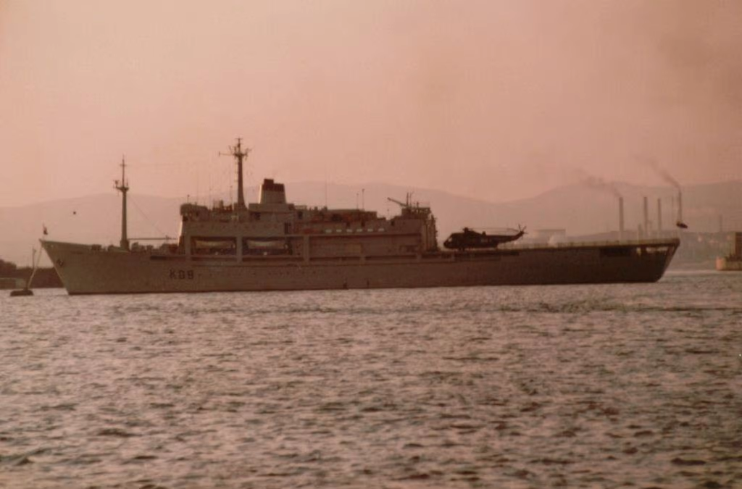
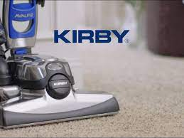
My Background
National Sea Training College
Royal Fleet
Auxiliary
RFA Engadine
Falklands Conflict
Algeria & North Africa
North Sea oil & gas rigs
Kirby salesman …
Notes:
At 16 I joined the National Sea Training College for the Merchant Navy.
At the end of my 16 weeks training I was offered an MOD(N) contract with the RFA.
My first ship was the RFA Engadine – Helicopter Support & Ammunition Ship.
At the age of 17 I was deployed to the Falklands Conflict with the task force.
After 6 ½ years I left the Navy but struggling to settle back in to local life I went to work on oil pipelines in Algeria & North Africa.
Following this I spent some time in the North Sea on the rigs.
Then somehow I got into sales…This was the start of my business path…..

Slide 4
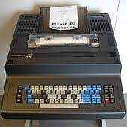
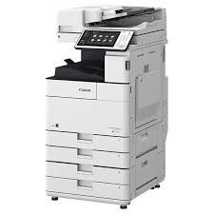
Into Business
Started selling telex machines into Embassy`s in the 90`s
Then moved around companies a couple of times searching for the right fit
After being with the same company for many years and being close to 50 the owner put the company up for sale
Do I suddenly become out of work after the sale at 50 with no qualifications as such and watch the other 25 people and families become destined to a similar feat… Or do I pitch for the business…….
So I re-mortgaged, borrowed what I could, took life savings and the kids savings to put enough on the table to be able to back myself with the banks to raise the investment needed to complete an MBO.
Secured jobs, changed what we sold and how
Developed a service driven business
Then bought 4 other companies over 3 years
Then in 2020 sold a large shareholding to clear all debts, further secure jobs and ensure family home life was back safe & secure
Notes:
I didn’t last too long selling over priced American cleaners in the valleys on a commission only basis , but had a taste of sales and the opportunities it may create
I joined a few office equipment & communications businesses learning my trade and watching how business worked and how to manage people.
Eventually ending up in a company in Cardiff where I could settle down and put roots in to normal life. Learning all the way and achieving my ILM 7 accreditation.
In 2015 I gambled with everything both myself and my family had worked for to complete an Management Buy Out of the company I was employed by , with probably the most stressful 5 years to follow, but the driver was to:
Clear all debts
Secure staff jobs in the company
Improve the business sustainability
And improve the CSR footprint of the company to help in the various communities in Wales
After supporting many local and national charitable organisations I was introduced in 2016 to the Armed Forces Covenant by RFCA Wales..

Slide 5
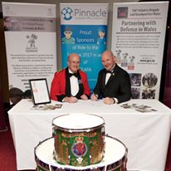
Drivers in supporting Armed Forces
Notes:
The meeting with Audrey the Regional Director for Employer Engagement after a friend and fellow Veteran suggested talking with her was the start of this journey.
This ultimately led to increased want & effort in trying to support our Armed Forces and Veterans, as well as pledging my support after signing the Bronze Armed Forces Covenant

Slide 6
Drivers in supporting Armed Forces
It All Started By Supporting
Notes:
Initially trying to support and do as much as we could both as a business and personally for local Charities but also by including some of the Armed Forces or Veterans Charities pictured here on the slide by way of events, golf days, donations, food parcels and many more challenges to raise funds and awareness.
Then when applying to be put forward to the Silver Armed Forces Covenant Audrey said I should look at this great little Welsh Veterans Charity….The rest as they say is history….

Slide 7
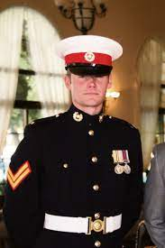
Why Woody`s Lodge
It was Woody’s dream… and now it’s ours
Woody`s History
Woody`s Vision
Woody`s Support
Family Feeling
Inspirational People
Small enough to care, big enough to cope
Notes:
So, Why Woody`s..
Firstly, I was completely overwhelmed by the Woody`s history, the dream that Paul had and how his loved ones wanted to deliver on Paul`s dream.
Secondly, the strength of the people there, from the few staff & founders to the volunteers and most important of all the Veterans and Emergency Services Personnel that were supported here. It really made the Vision easy to see.
For such a small organisation, Woodys staff & volunteers are punching well above their weight to ensure the support is given to every single person who either freely walks across the door step, is referred to us by another organisations, or by bigger bodies such as the NHS, DWP, RBL, SSAFA and HMP.
Not only this but there is a truly visible connection with the families and children of these Veterans & Emergency personnel that you can see they are supported and assisted with any of their challenges.
Whether it is a simple catch up, a quiet moment overlooking the gardens, having a wet or a brew, advice from a welfare officer or just someone to talk to, the Woody`s family is just that… A family with open arms and a smiling face that can offer warmth and support no matter what the circumstance.
The staff and volunteers at Woody`s are amongst the most sincerest and hardworking people I have ever met, Woody`s deliver a lot to a lot of people yet month on month they constantly work to keep stability in the organisation to create a charity that is sustainable. They are truly inspirational all of them. Staff, Volunteers & Trustees. For me that is why Woody`s Lodge. If I can help them in 100th of what they do then I know its time well spent.
Small enough to care, big enough to cope…

Slide 8
Final Thanks
To everyone here for listening
And to ASDIC for the opportunity
Notes:
So, hopefully I haven’t kept you from your brew.
Thank you all for listening to me
And thank you to ASDIC for inviting me to say a few words on how businesses should get involved with supporting Veterans. See you in the bar later….

