Slide 1

RFEA and Veterans Employment
Alistair Halliday
Thu 5 May 22

Slide 2

Agenda
Context
What we do
How we can help
Forces Employment Charity

Slide 3
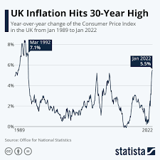


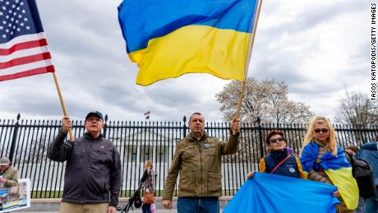
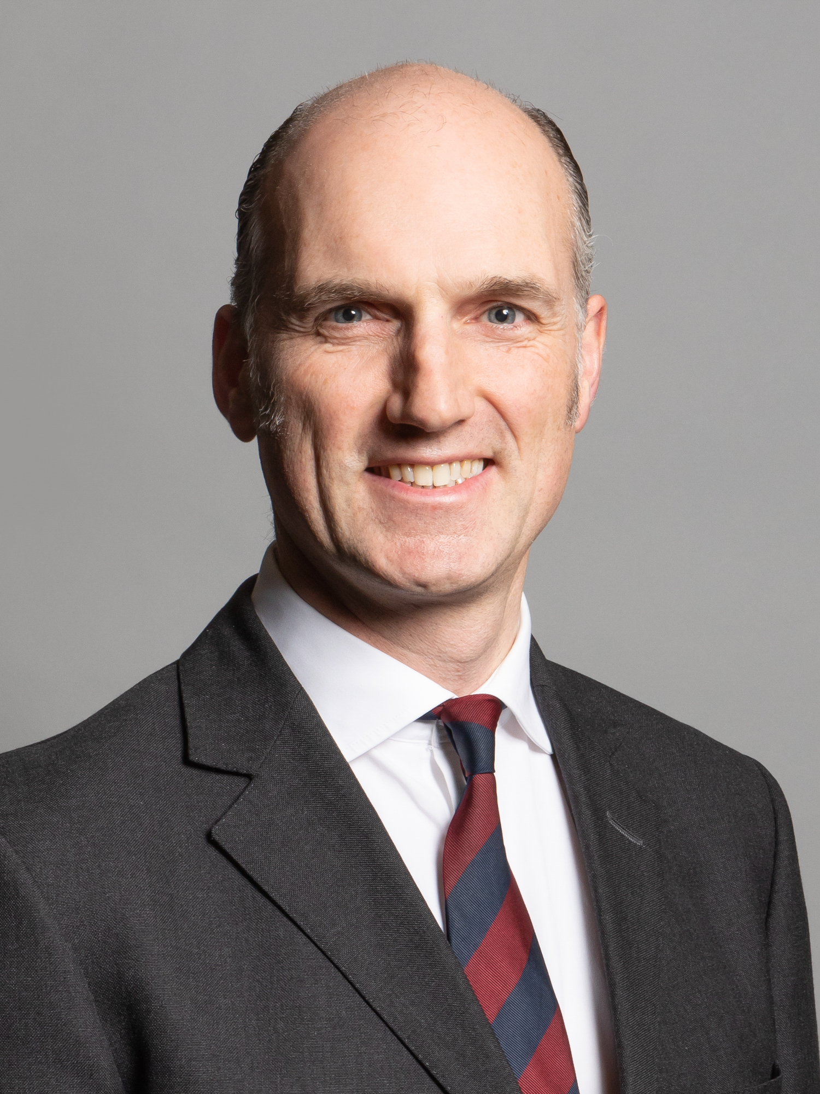

Context
Economy, Jobs and Inflation
Post Covid..
Ukraine and Afghans
Collaboration

Slide 4

Our Vision
Our Mission
The Forces Employment Charity exists to provide life-long, life-changing support, job opportunities and training to Service leavers, reservists, veterans and their families, irrespective of circumstances, rank, length of service of reason for leaving.
Founded in 1885
Our vision is a UK where all veterans and their partners lead fulfilling working lives.

Slide 5
Why Employment?

Slide 6




Our Programmes
Employer Relations Team
CTP Future Horizons - ESLs
CTP Assist- WIS
Client Support Centre
Regional Employment Advisors
Specialist Vocational Advisors
Forces for London
Families Programme
Military Women
TechVets
Project Nova
(New 2022) Afghan Support
(New 2022) EM3
(New 2022) Emp Support RBL
Career Consultants
Employers/Jobs board
Events team
Notes:
1) Accommodation
Living Skills & Self-Care
Mental Health & Well-Being
Friends & Community
Relationships & Family
Parenting & Caring
Drugs & Alcohol
Positive Use of Time
Managing Strong Feelings
Training & Employment
A Crime Free Life
2) Coordinated support
A Seamless Experience
Partnerships
Multi Agency Working
Information sharing
Collaborative
Holistic
Empower desistence
NST tracking & support
Efficient

Slide 7
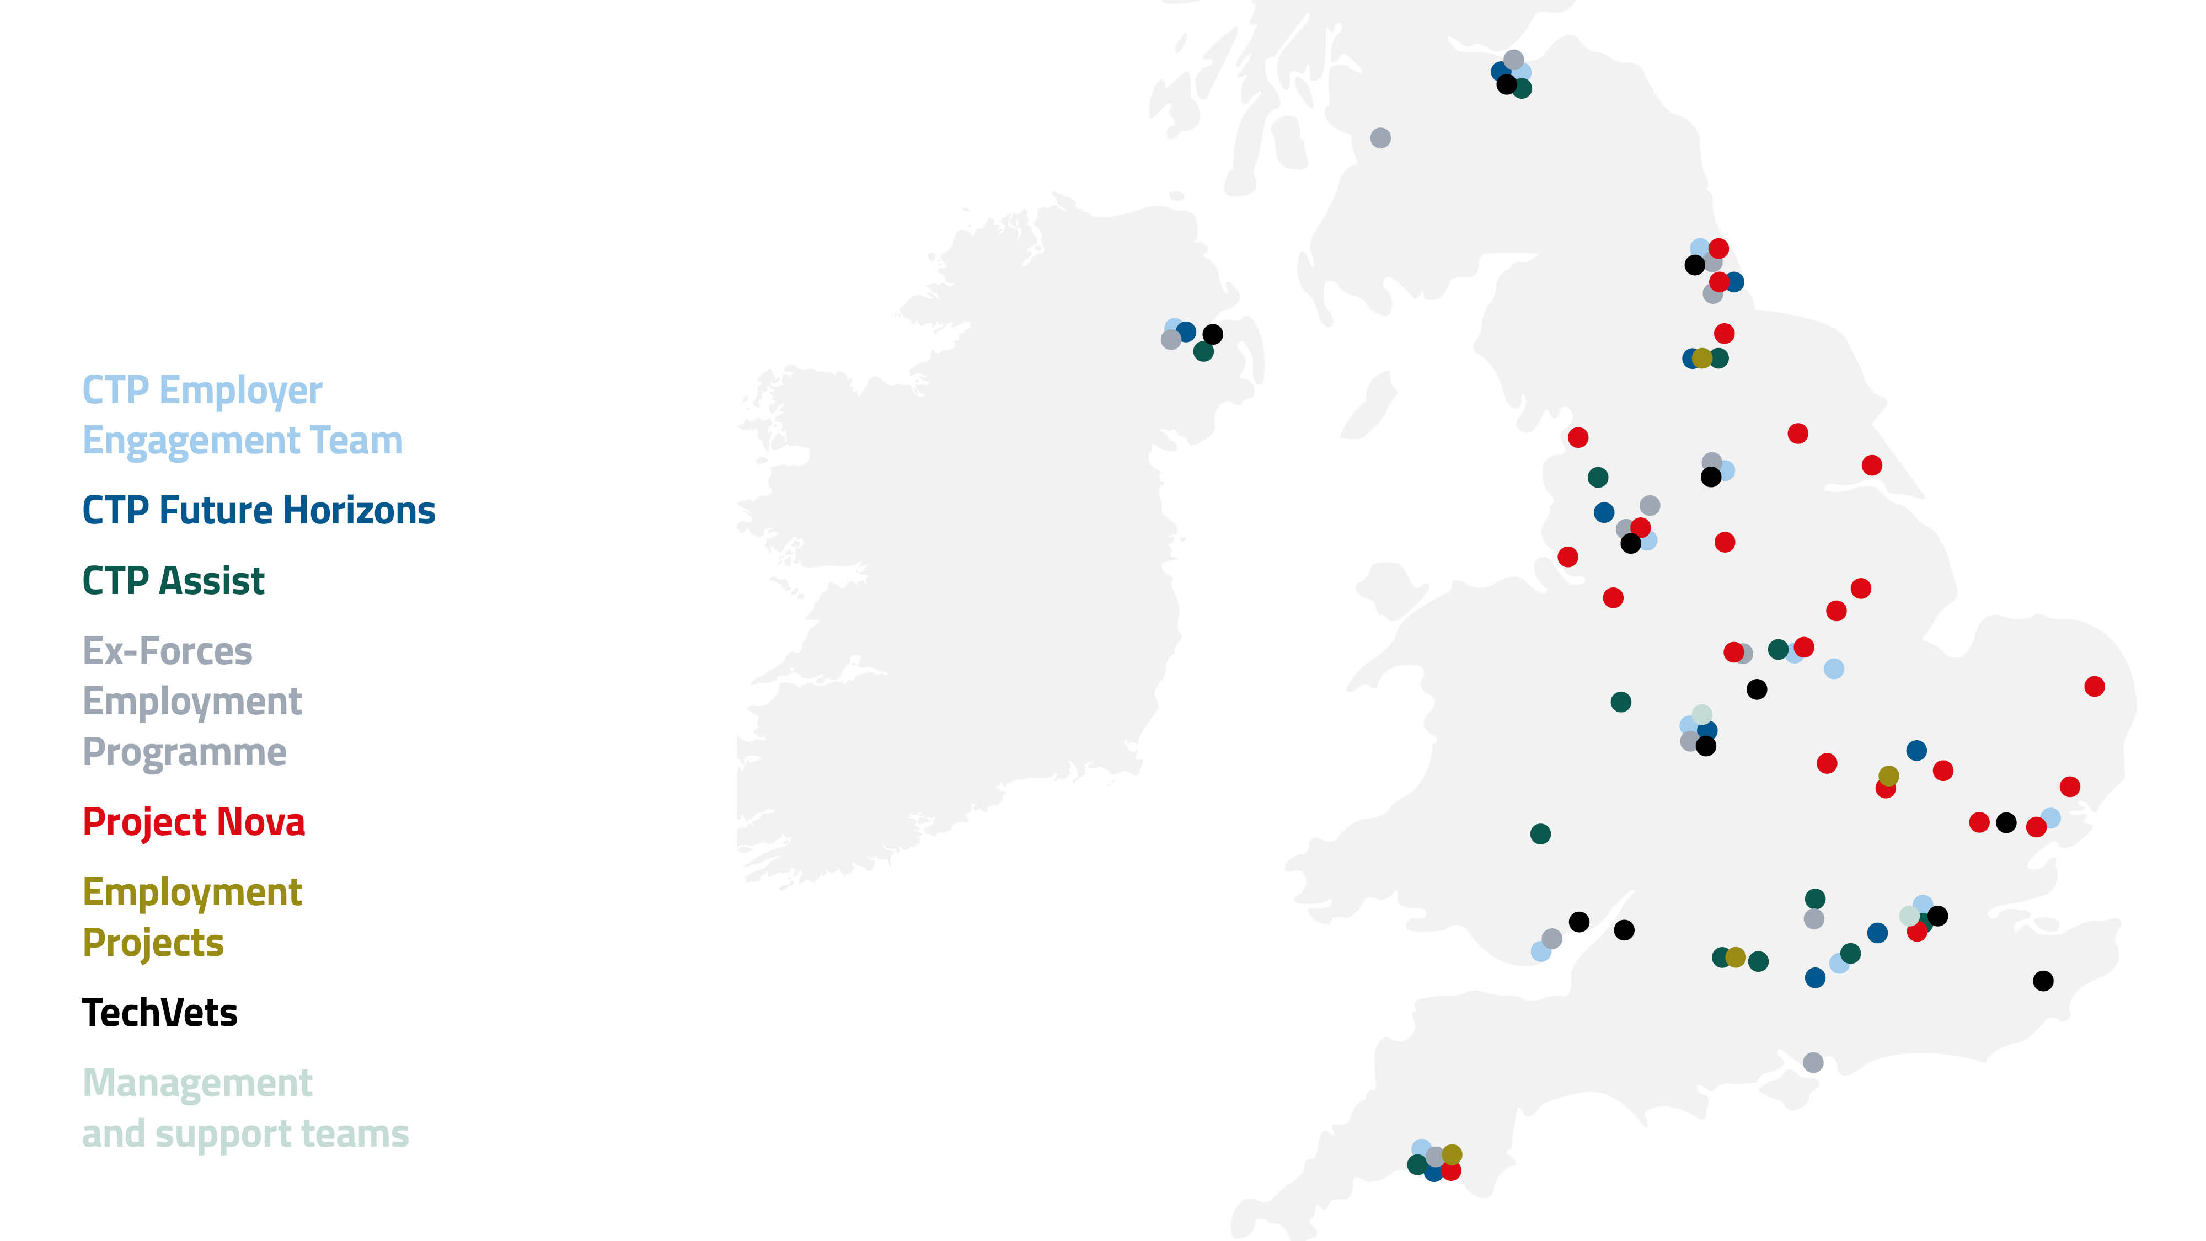
Our teams

Slide 8
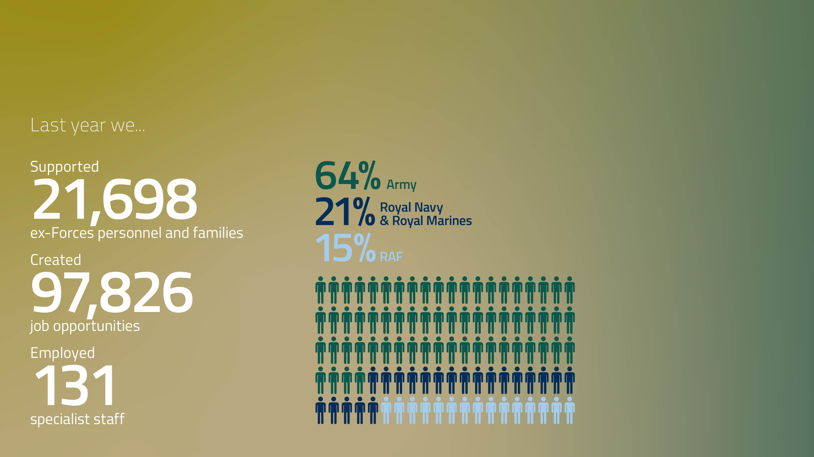
Our year in numbers

Slide 9
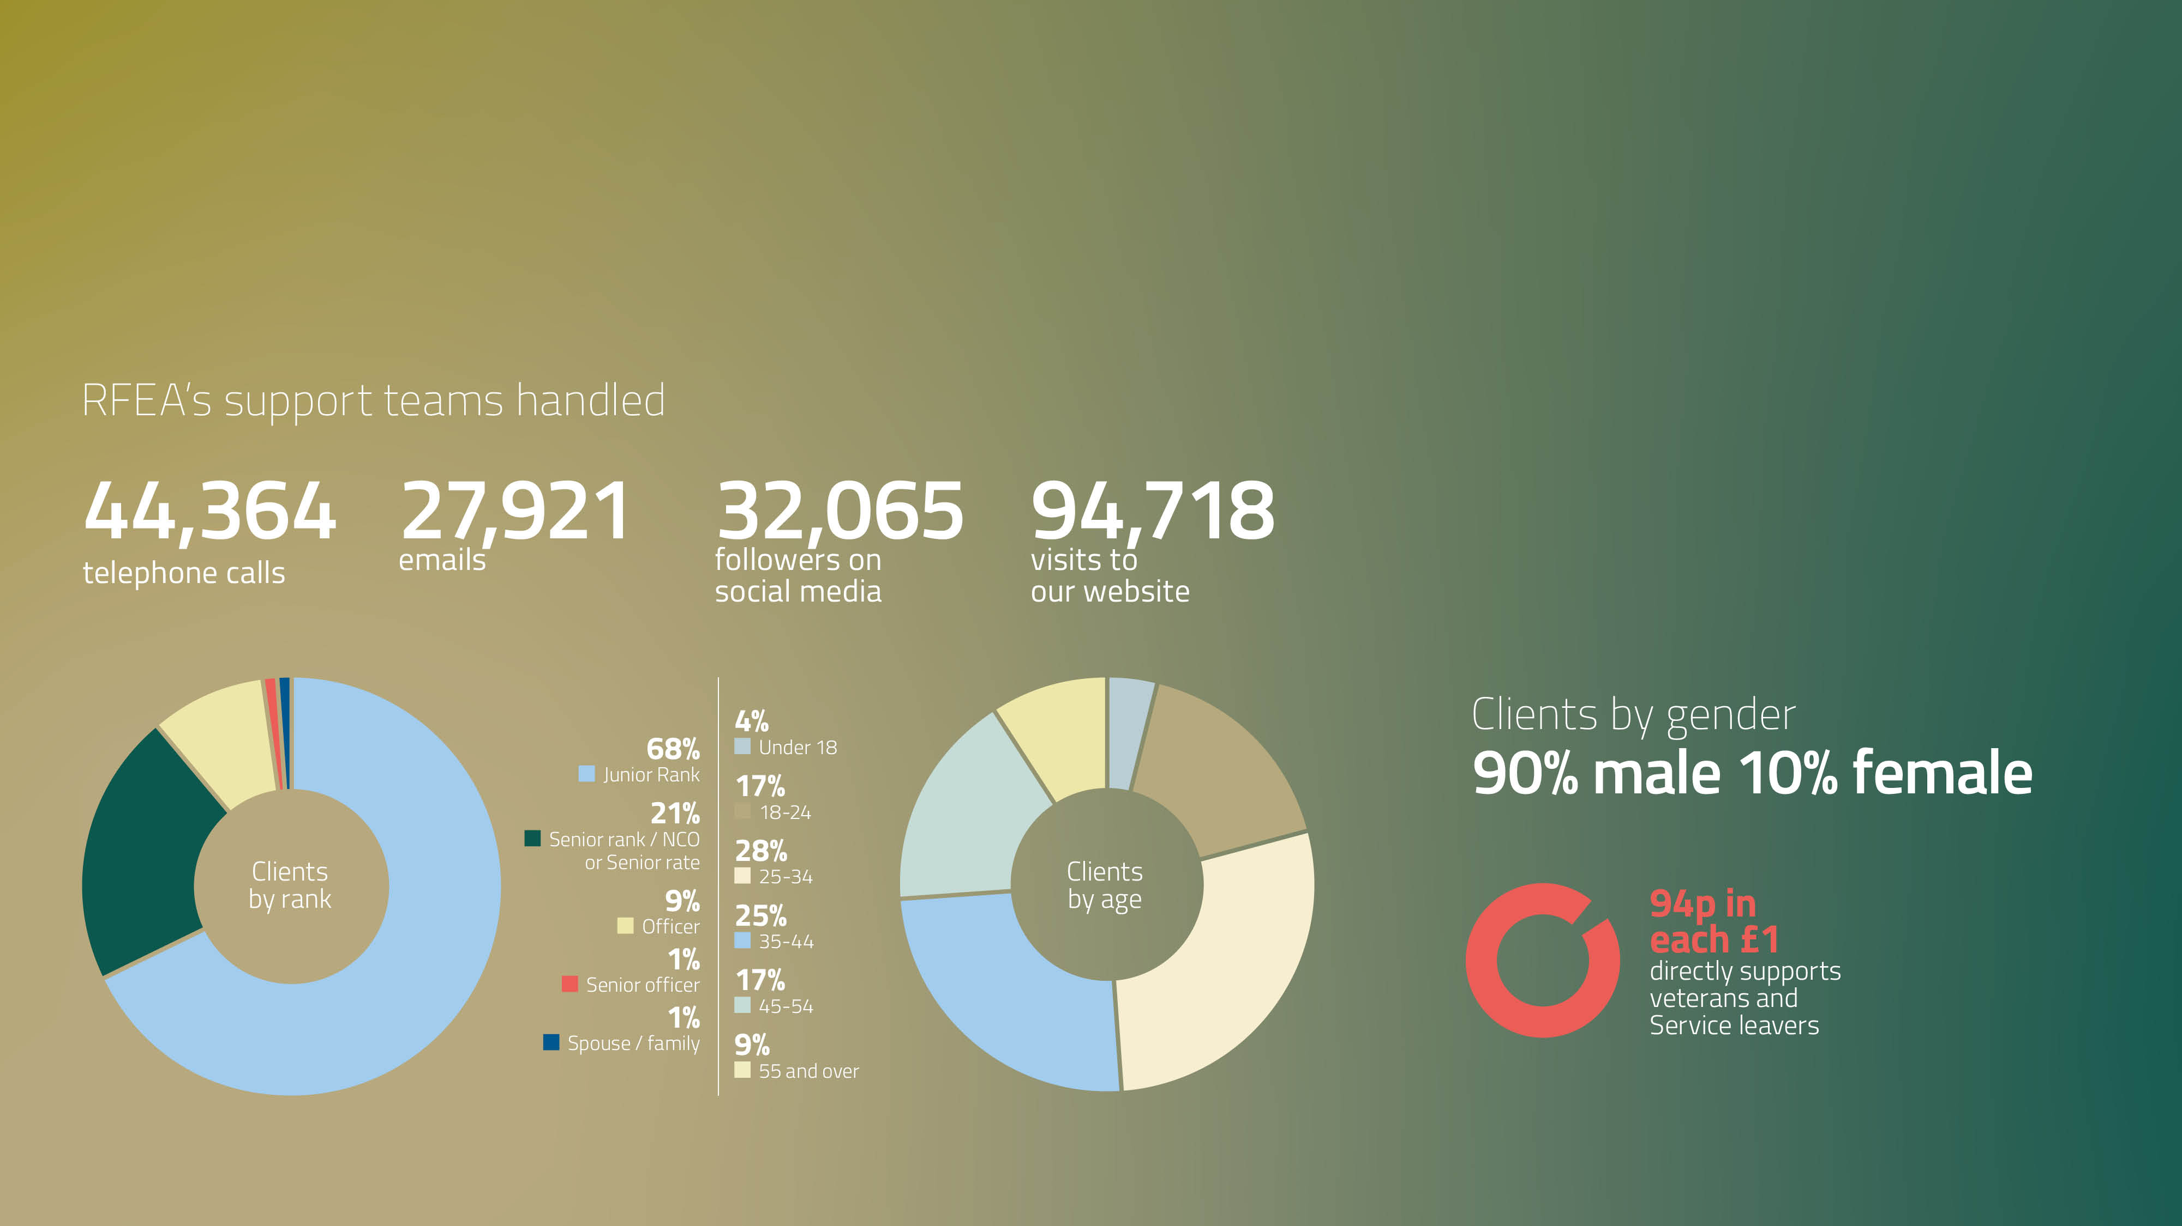
Our year in numbers

Slide 10



Supporting transition -
RFEA successfully delivers employment services into Right Management for the Career Transition Partnership (CTP) MoD resettlement contract
CTP Employer
Engagement Team generated
97,826
job vacancies for
ex-Forces personnel –
a 47% year on
year increase
We hosted 78 online
employment events
attended by 2,784 clients
CTP Future Horizons supported 3,519 clients
CTP Support Team handled
27,427 calls and 16,599
emails with Service leavers
and employers
As an employer of Service leavers and veterans we have a strong relationship with RFEA’s CTP Employer Engagement team, ensuring we can help with the transition to the world of field engineering.
Mark Comerford, Resourcing Manager, Openreach

Slide 11

Supporting Veterans
Life-long employment support for veterans and reservists throughout the UK
Our veterans’
advisors supported
4,210
63%
increased their aspiration
and motivation
55%
of Veterans’ Programme
clients were supported
into jobs
My advisor helped me
reposition my skills and experience,
so they made sense in civilian terms. With her coaching I was able to convey my passion for the role
and I got the job!
Celine, now an Early Years Practitioner
clients

Slide 12

Supporting those who need specialist help
Longer, more intensive support for those further from employment
Our specialist
advisors supported
329
75%
improved their
health and wellbeing
95%
of SVA clients were
supported into jobs
I didn’t know what I wanted to do and that can be quite daunting, but my advisor made me realise that doing something is better than doing nothing. Thanks to her guidance and support,
I gained qualifications that have led to my current job, helping people with their mental health issues.
Lance, now a Peer Support Worker
in the NHS
clients

Slide 13

Supporting families
Working collaboratively to increase families with two working adults in the armed forces community
Our Families
advisors supported
370 spouses, partners
and widows
94%
increased their
job search skills
78%
of Families Programme clients
were supported into jobs
My advisor made me realise there were places offering help
that I never knew existed. She introduced me to the Royal British Legion for funding and now I’m taking a night class. I don’t know how I could ever repay RFEA.
Senorita, now working part-time
while studying

Slide 14


Delivering this innovative programme enabling Service leavers and veterans to access cyber and tech roles
TechVets supported
3,084
Each TechVets client
receives free training up
to a value of £25,000
The average income of a successful TechVets client
is over £44k
RFEA has been a solid rock for me since I contacted them. They recommended me to TechVets which has also helped me greatly
as I get access to unlimited labs
and resources.
Daniel, now training for a career
in cyber security
serving military, service leavers and veterans

Slide 15

Forces for London
- unemployed veterans in London
35% of veterans Forces for London clients supported were from ethnic minority backgrounds
Our Forces for
London advisors supported
106
94%
improved their workplace
and social skills
60%
of Forces for London clients were supported into jobs
Veterans can face certain challenges when it comes to translating military experience into skills relevant to the civilian world, so having the RFEA team behind you helps you know that you’re
not going it alone.
Ernest, looking for work in finance
clients

Slide 16


Military Women
Supporting female
veterans and promoting
their unique skills
Our Military Women advisor supported 159
76%
increased their
job search skills
50%
of Military Women clients were supported into jobs
My advisor made sure I met targets we’d set, whether it was
CV writing or personal development. The support really helped me realise my potential and I ended up with two job offers.
Alex, now an adventure training course designer
clients

Slide 17


Project Nova
Life changing and life saving support
Extending our specialist support for veterans in the Criminal Justice System
Our specialist caseworkers supported 1,226
86%
improved their
health and wellbeing
19%
of Project Nova clients
were supported into jobs
I felt so lost and like everything was down to me and that got me down, I felt like I had nowhere to turn. Project Nova’s support made a big difference to me and my family, they have definitely helped us through some rough patches.
Rachel, now a self-employed massage therapist
clients

Slide 18
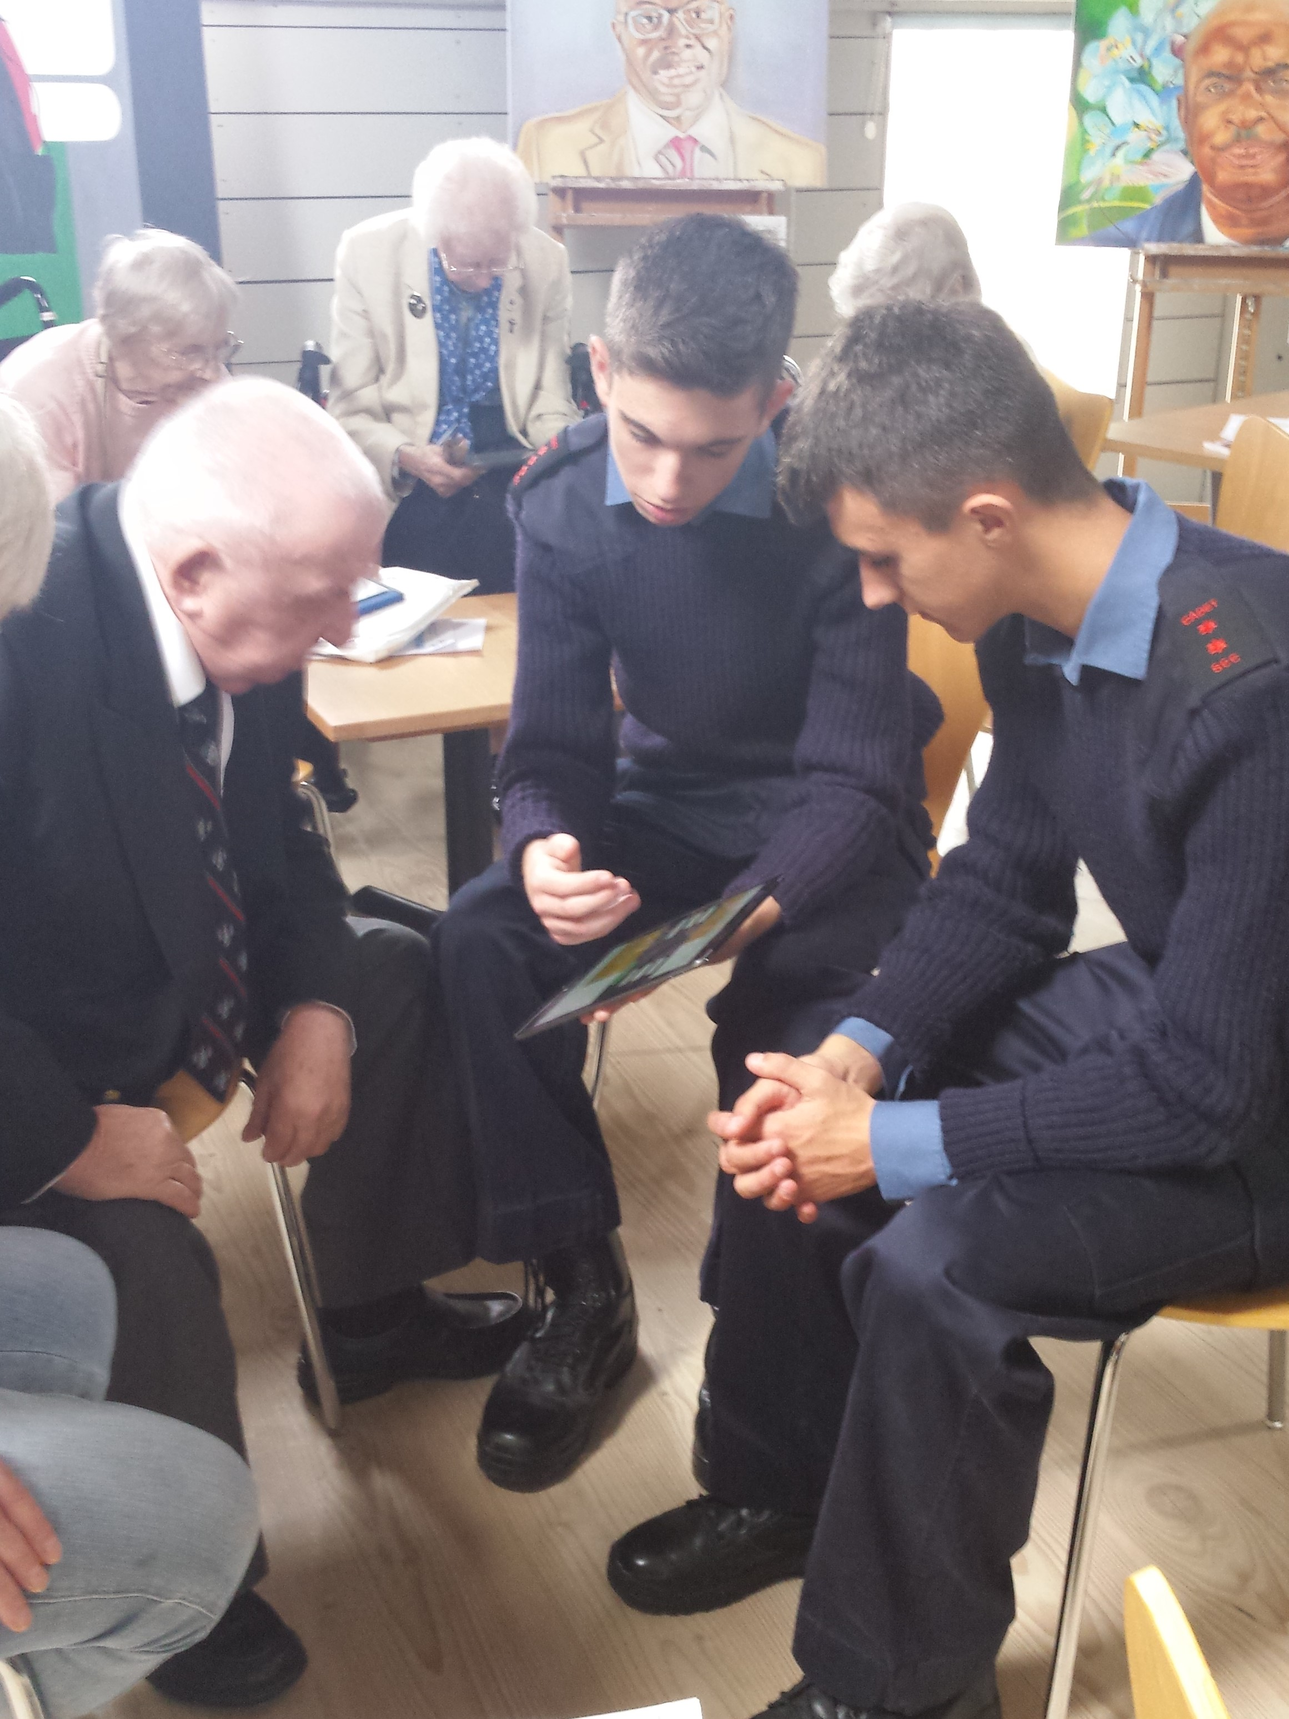

New programmes
Digital Poverty – Project STRIDE
  What? - Syllabus
  How? - Devices
  Who? - Trainers
  Where? - Venues
Afghans into Employment
  AFCT support
“One is too Many” programme
EM3
Executive…

Slide 19


Slide 20

Summary
Employment support remains a critical area
CTP remains the key programme for transition but veterans now better supported with large number of new successful programmes
Combination with OA to form Forces Employment Charity provides a great opportunity
Need for collaboration and cooperation never been higher
Veterans need our support - but need to be championed too

Slide 21



Thank you

Slide 22

alistair.halliday@rfea.org.uk
https://www.rfea.org.uk

Slide 23
Employers
Service
Leavers
(CTP)
Employer Relationship Managers
Veterans
Right Job
Lowest
Need
Central Support Team
CTP Future Horizons
Regional Employment Advisors
Ex Forces
Regional Employment Advisors
CTP Assist
Specialist Vocational
Advisors, Project Nova & Partner Programmes
Online Tools
Career Planning, CV Writing, Applications & Interviews
Page 23

