Slide 1



Slide 2

Forward Assist
Multi-Award Winning ‘Veteran Centric’ Registered Charity & Campaign Organisation Based in The North-East of England. Charity Number 1150408
National & International Geographic Footprint.
Research – Education – Advocacy - Psycho-Social Support
Veterans Health & Wellbeing Community Hub with ‘Drop In’ and ‘Walk In’ Service in Salute Cafe
Identity –Transition – Adjustment – Assimilation
Social Work Model of Engagement – Assessment - Case Management – Care Coordination
Salute Her UK ‘Gender Specific’ Women Veterans Research Collaborative & Trauma Informed Support Service.
Dedicated LGBTQ+ Veteran Care Support Worker.

Slide 3
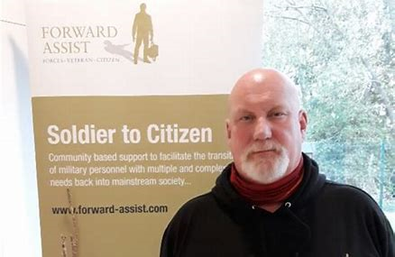
Tony Wright CEO & Founder Forward Assist
Tony is a qualified, registered Social Worker, Probation Officer, Advanced Group Worker & Former Home Office Adviser.
He is the CEO & launched ‘Forward Assist’ after returning from a Churchill Fellowship funded research trip to USA in 2011.
In 2017 he founded Salute Her UK, now a registered charity in England & Wales thanks to support from the Churchill Fellowship Activate Fund.

Slide 4
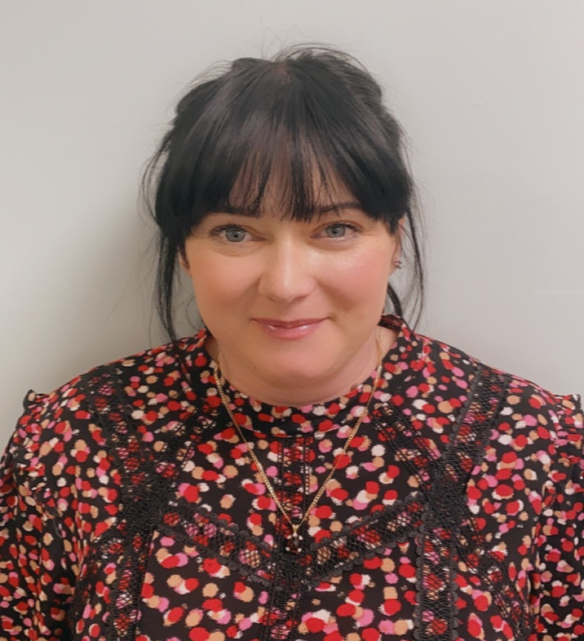
Paula Edwards
Salute Her Project Manager
Paula Edwards is a qualified Mental Health Therapist & the ‘Salute Her’ project lead. She is also a member of the All-Party Parliamentary Group (APPG) on Suicide Prevention.
Over the last 2 years she has identified and engaged with over 2000 women service personnel and veterans, providing gender specific therapeutic activities and one-to-one trauma informed consultation & therapy sessions.
She also facilitates MST support groups for female serving personnel &veterans, therapeutic residential retreats, online peer-led support groups, access to pro bono legal advice, therapeutic art & fitness classes, and British Parliamentary Debate training.

Slide 5
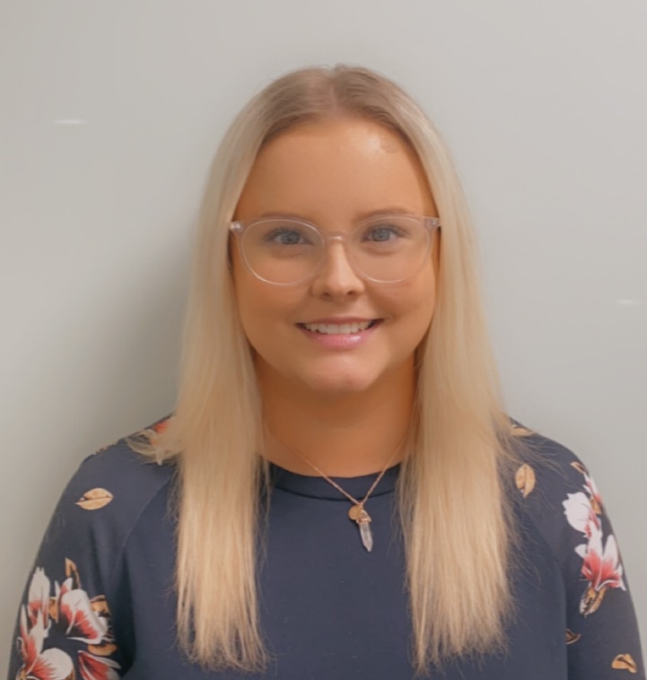
Nicole Dodds: Military Family Project Worker & LGBTQ+ Veteran Care Coordinator
Nicole is a university graduate,qualified in systemic family practice and childhood development.
Over the last 8 months she has identified and engaged with over 45 civilian based family support organisations and connected over 20 military families with civilian based support. She has also organised family activity days, free childcare and access to legal advice from a family law solicitor.
In her role as LGBTQ+ Veteran Care Coordinator she provides 1-2-1 support & has initiated a LGBTQ+ virtual support group which includes a national consultation exercise to asses unmet need.

Slide 6

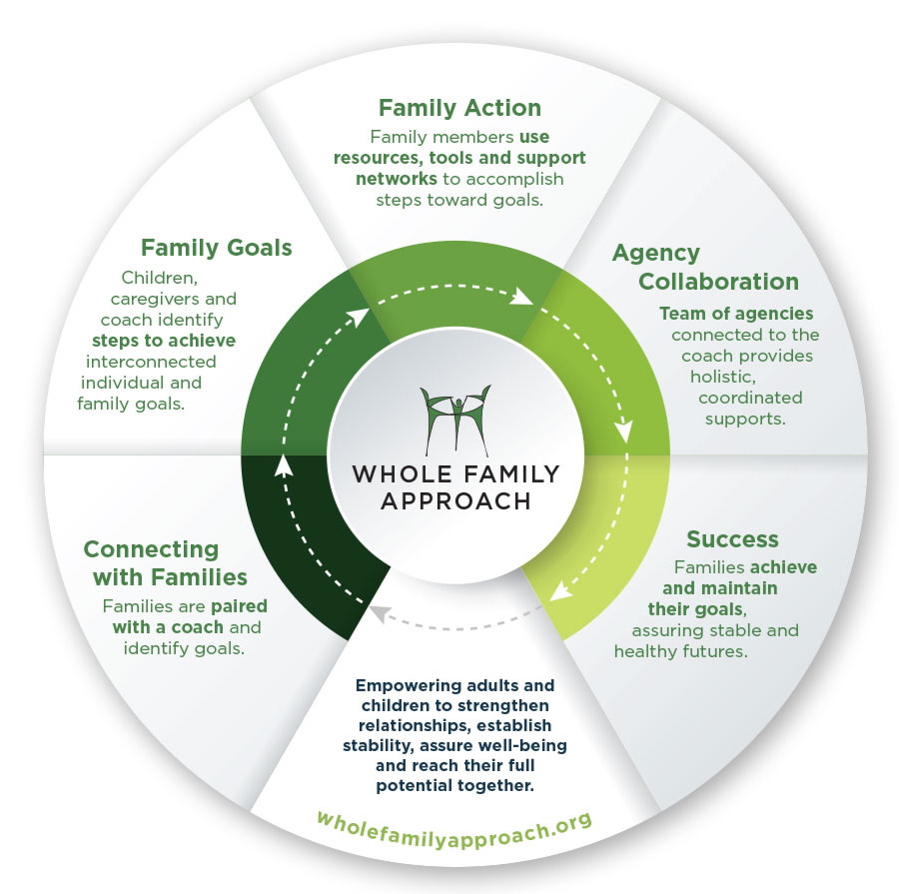
Whole Family Approach

Slide 7
Divorce
Grief
Addiction
Unemployment
Parenting Issues
Issues Military Families Face

Slide 8
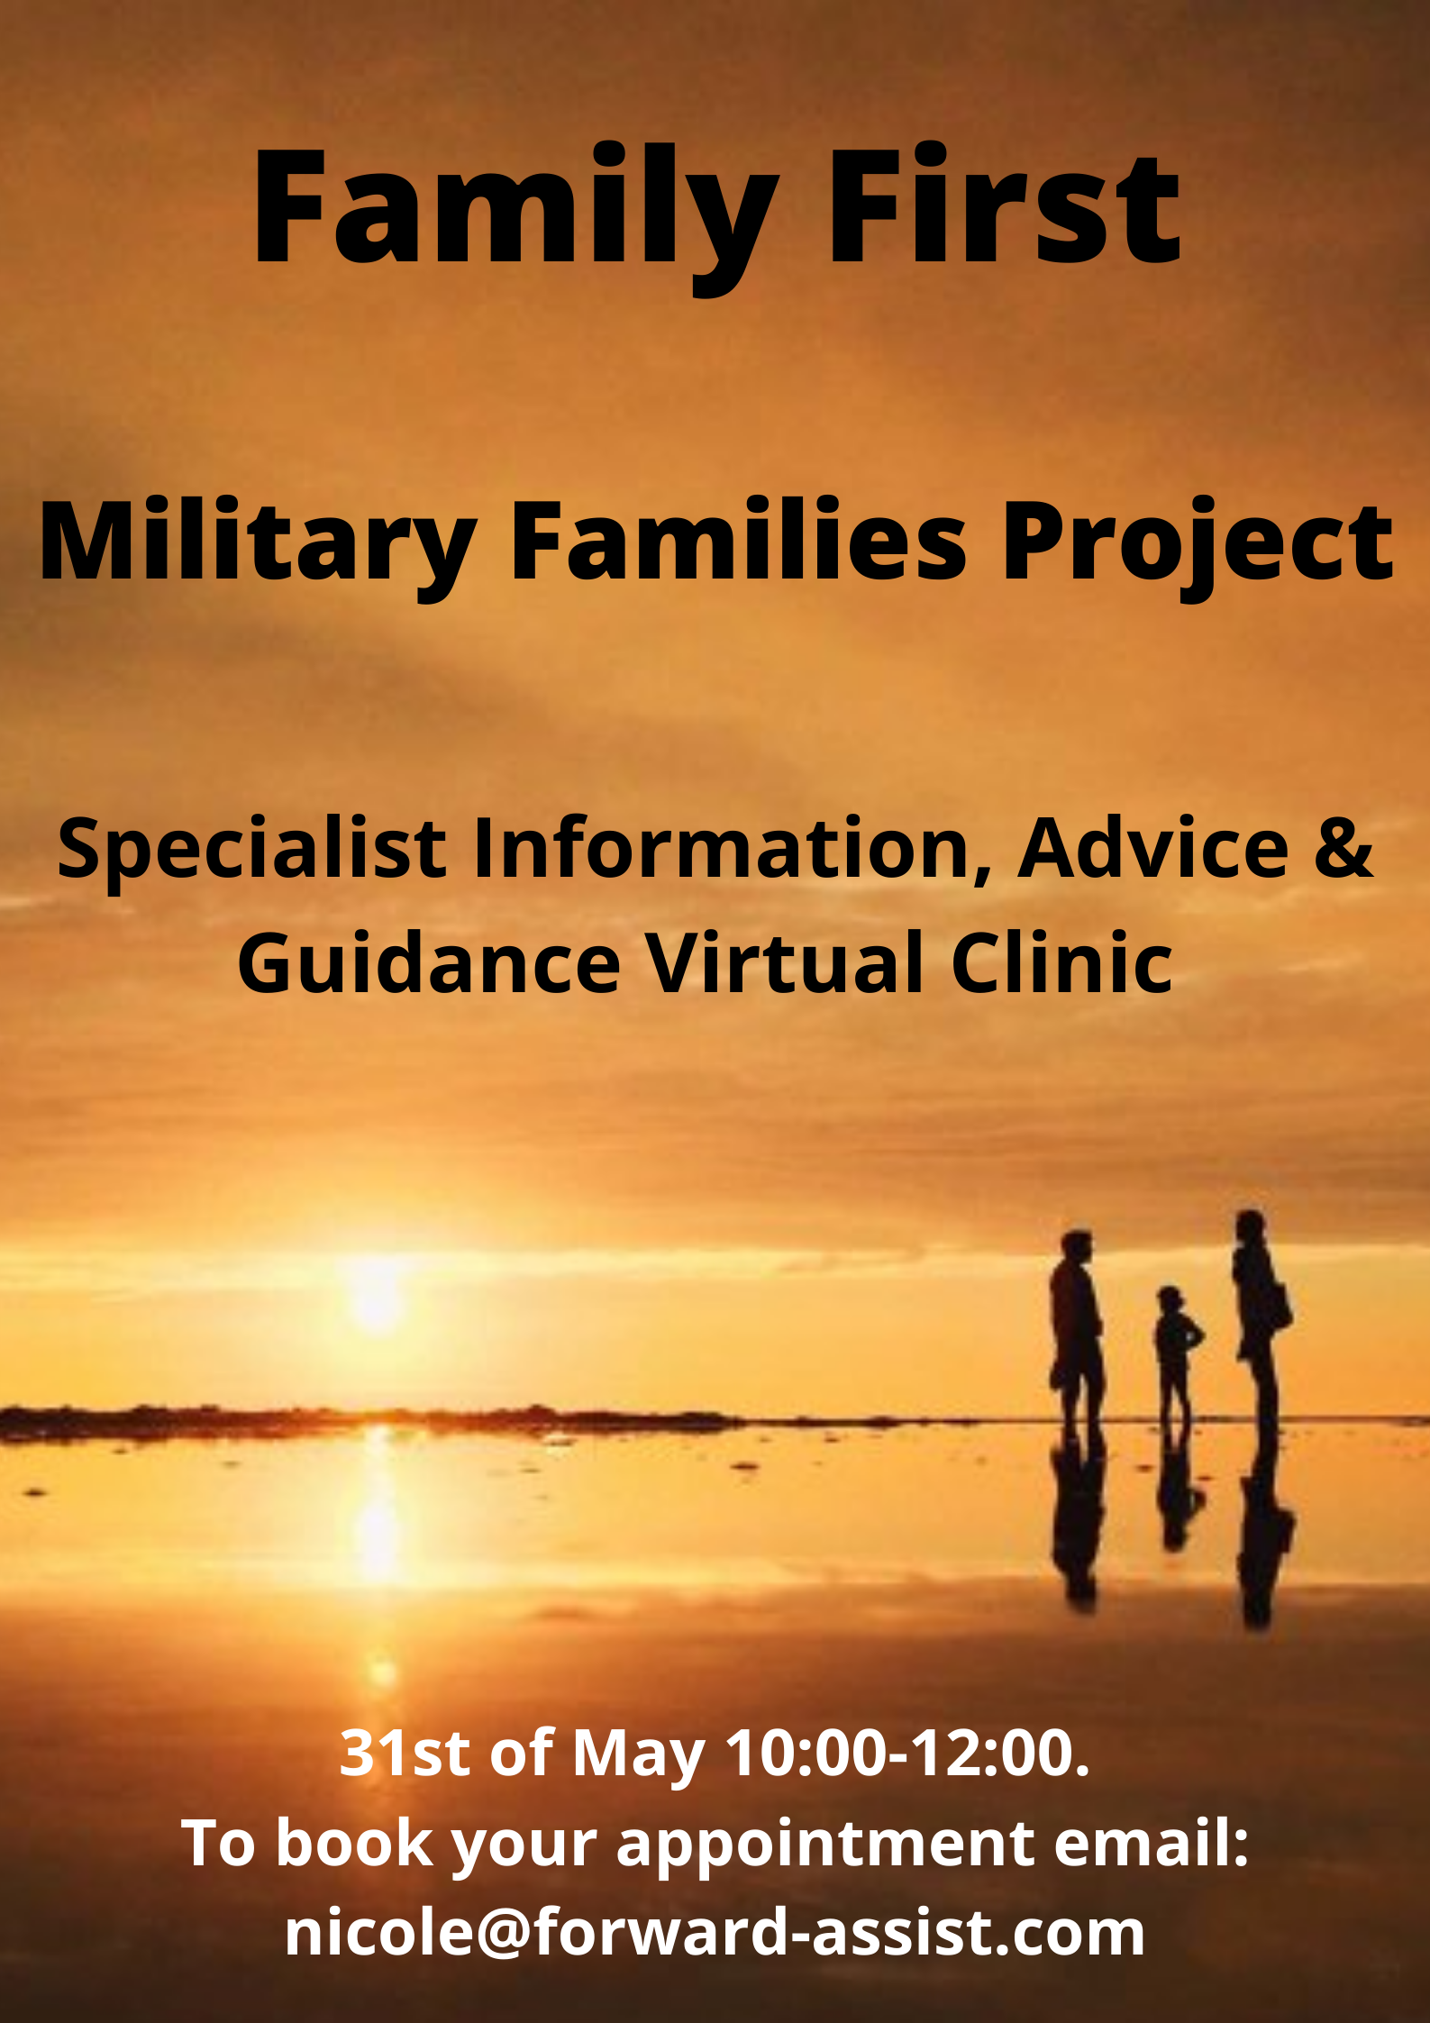





Family Services

Slide 9
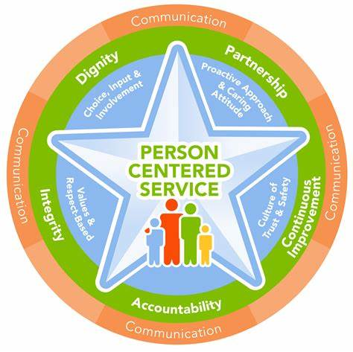
Person Centred Support

Slide 10
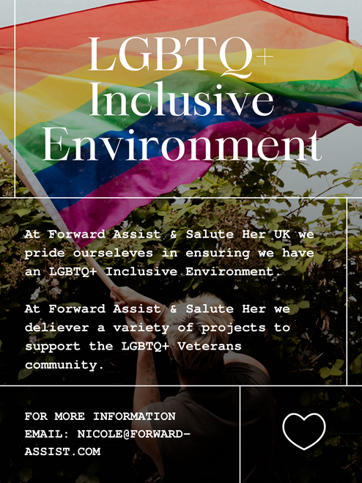


Slide 11
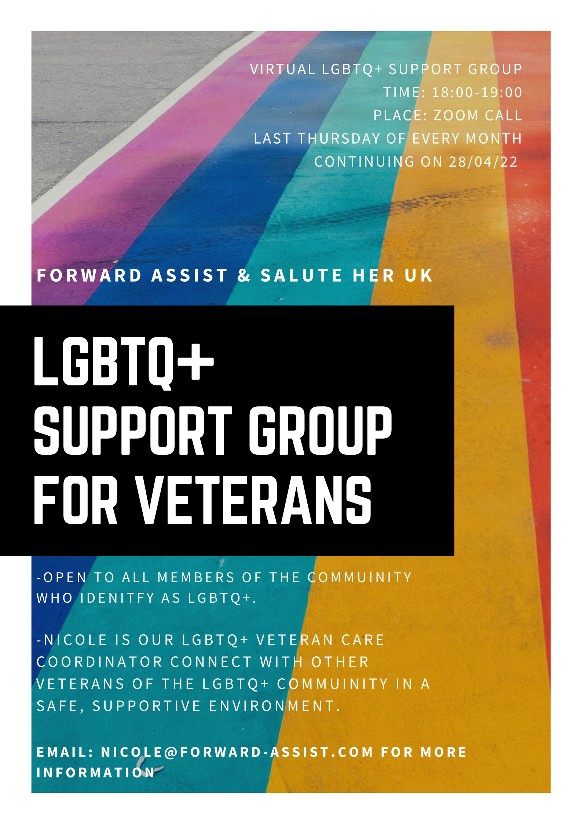
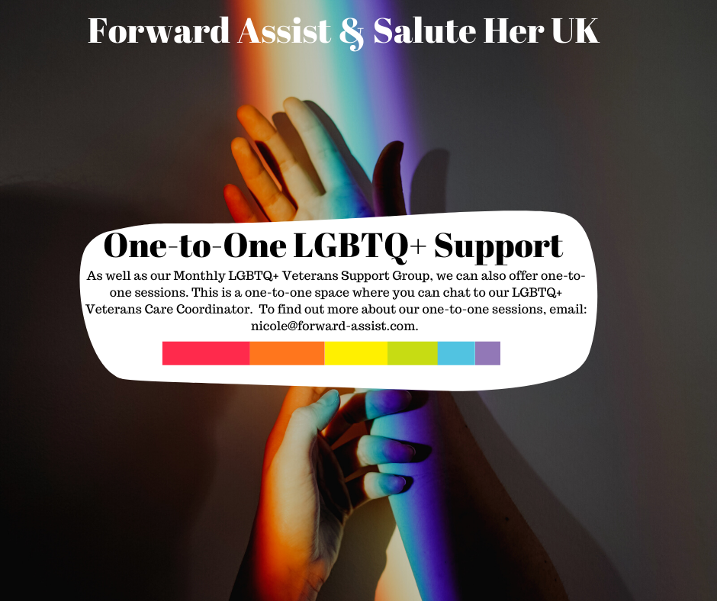
LGBTQ+ Services

Slide 12


Services that we provide
Gender Specific Veteran Drop In X 2 (IAG)
Horticulture
Veterans Retreats
1-2-1 Financial Wellbeing
British Parliamentary Debate Training
Scale Model Making
Creative Writing
Life Coaching Sessions
Outdoor Activities
Women Veteran Only Mindfulness of Dream & Sleep Courses.
Family Virtual Gym Session.
Military Young Carer Workshops
Suicide and self harm workshops for all trauma victims
Domestic Violence Course
One to One person centered therapy sessions.

Slide 13
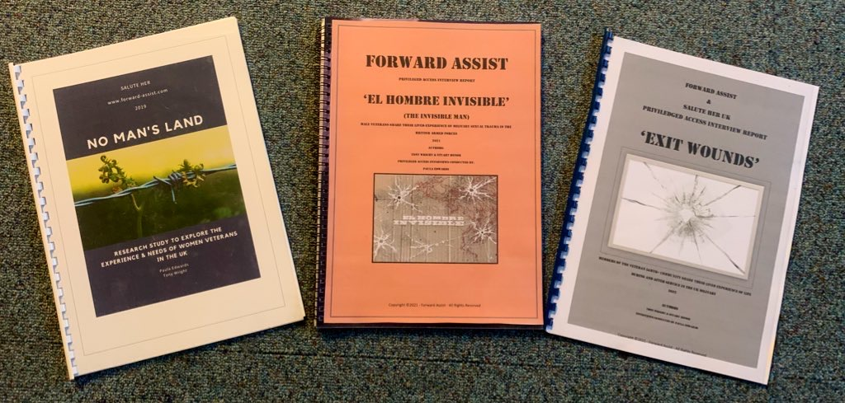
Military Sexual Trauma Research www.forward-assist.com

Slide 14
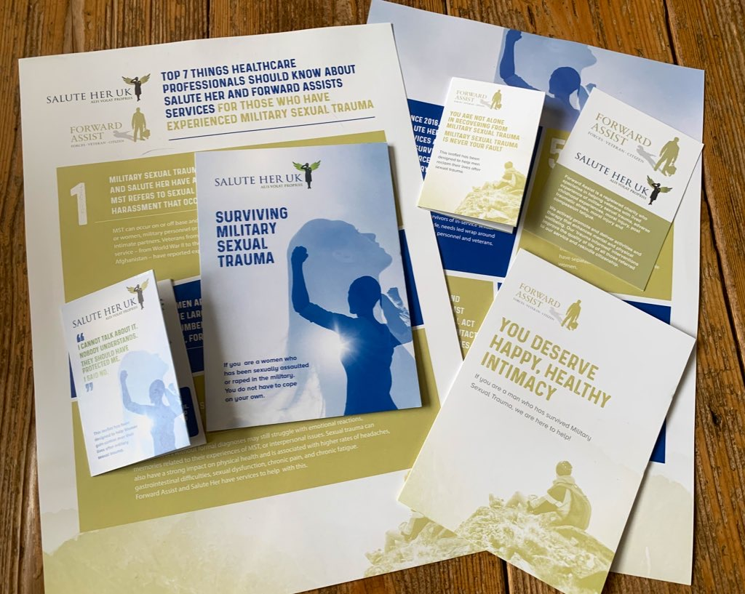

Slide 15


Slide 16


Slide 17
Chief Executive:
Tony Wright
tony@forward-assist.com
Women Veterans
Project Lead:
Paula Edwards
paula@forward-assist.com
Family First Team:
Nicole Dodds
nicole@forward-assist.com
Office Headquarters:
Forward Assist
Veterans Health
& Well-being Hub
c/o John Willie Sams Centre
Market Street
Dudley
Northumberland
NE23 7HS
Contact Details:
0191 250 4877
admin@forward-assist.com
www.forward-assist.com
Charity No. 1150408
Company Limited by

