Slide 1
Veterans Outreach Support
ASDIC Conference 2022
Royal Armouries Leeds
Ian Millen – Chief Executive
Notes:
Welcome and introductions

Slide 2
Our Origins
Founded in 2008 following Falklands 25th anniversary
Monthly Drop-In at the Royal Maritime Club
Veterans of all 3 services + Merchant Navy + families
Founders:
Morgan O’Connell
Joe Erskine
Ann Townsend
David Watts
A social forum for veterans and their families
A one-stop-shop for general welfare problems
Immediate access to mental health support
Notes:
Founded in 2007 just after the 25th anniversary pilgrimage to the Falklands sponsored by SAMA.
Began with 5 people, beer and skittles in the basement of the Royal Maritime Club before the term PTSD had been coined.
Provides:
Venue to meet other veterans
Drop-in to see a psychiatrist and therapist immediately (+ alcohol services)
One stop shop for general welfare/material needs.
This year (2018) is our 10th anniversary
Recently awarded the Queen’s Award for Voluntary Service: proud to display the logo top right

Slide 3
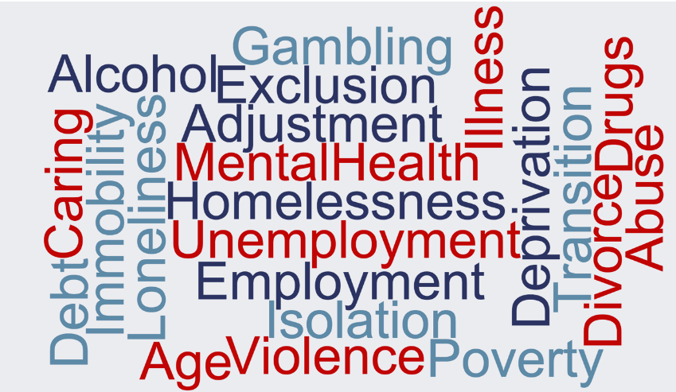
Our Veterans’
Challenges
TRBL Household Survey 2014
Notes:
We cater for all and every need.
This list is from the RBL Household Survey (but could have come from our reception desk, our agencies or SUs).
Only 60% of working age veterans are in work: often underpaid, overqualified for what they are doing
Most of our SUs are older: 64% over 65, 46% over 75
Some are homeless but many more find themselves in unsuitable housing
Many suffer from poor health, especially hearing, seeing, heart, diabetes, musculoskeletal problems
A number are alcohol dependent (twice as likely as the general population)
And we see a number of ex-offenders as well
Of our Service Users: ~50% need MH support; ~30% declare alcohol problems; ~10% drug misuse; ~25% need MH intervention.
Biggest needs are poverty and loneliness

Slide 4
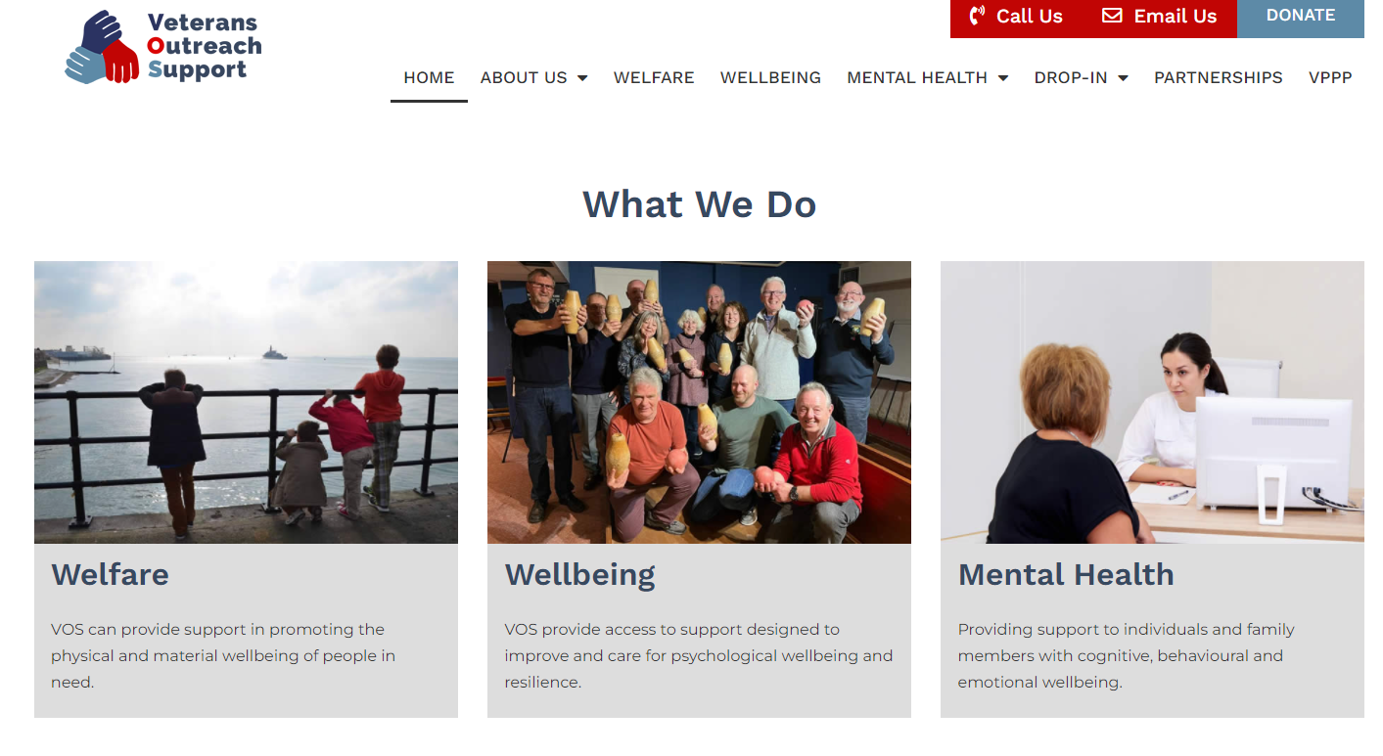
Our Services (Holistic)
Financial
Legal
Housing
Employment
Mobility
Etc
Psychiatry/Psychology
Mental Health Therapy
Addiction Recovery (Alcohol/Drugs)
Activities (Indoor/Outdoor)
Social Groups
Befriending

Slide 5
Our Operating Model
Referral
Walk-In
Family
Affiliates
SSAFA
Reception/
Registration
Combat
Stress
RBL
SOCIAL FORUM
Legal,
Finance,
Housing,
Job etc.
General
Welfare
Mental
Health
Support
In-House
Team
Immediate Triage may lead to Clinical
Therapy
H4H
TILS
Ripple
Pond
Wellbeing
Shore
Leave
Haslar
+35
Chaplain
Warrior
NHS
Peer
Mentors

Slide 6
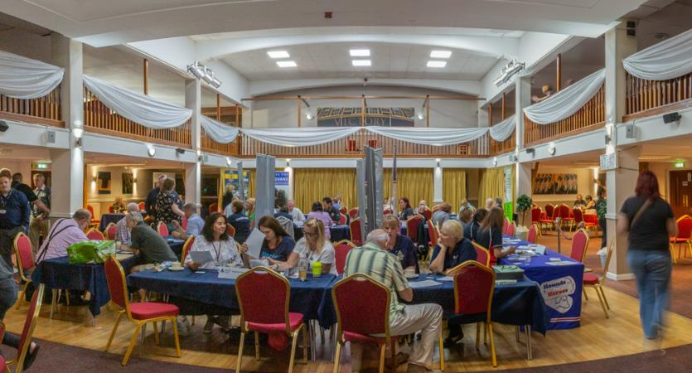
Our Approach Collaborative
“The volunteers and staff have a good understanding of what is needed for veterans and their families.” – Feedback from Service User.
Notes:
Royal Maritime Club
Reception RHS, agencies at tables, coffee/social area, ballroom. Social need - free coffee & biscuits
Next to volunteers, our location is our biggest asset

Slide 7
Our Drop-In Partners
(Welfare)

Slide 8
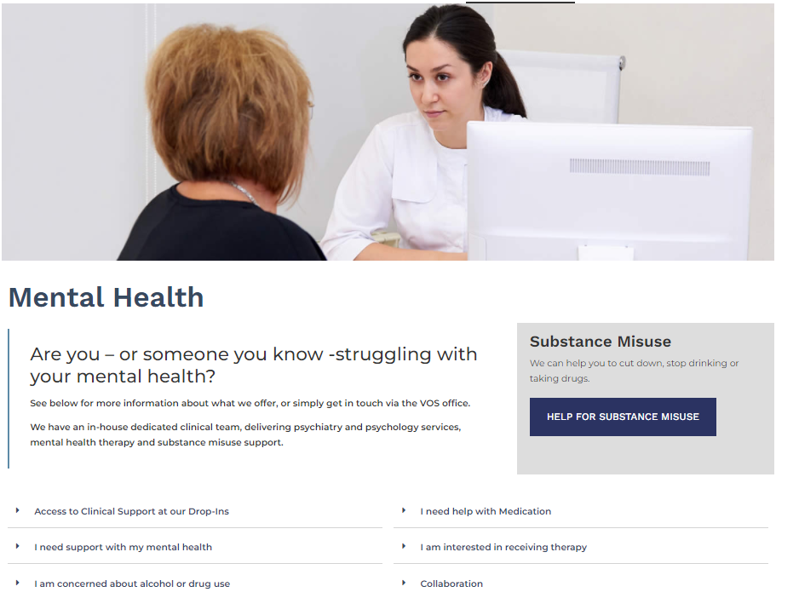
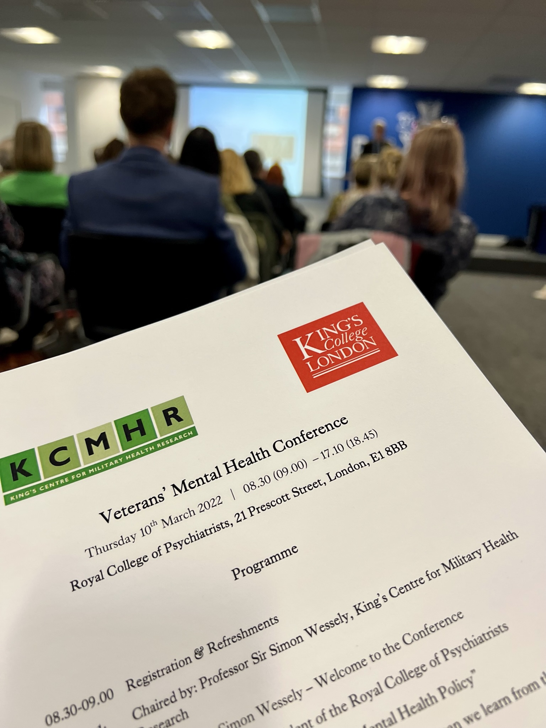
Mental Health
In-house team
Psychiatry/Psychology
Trauma-focused therapy
Addiction support

Slide 9
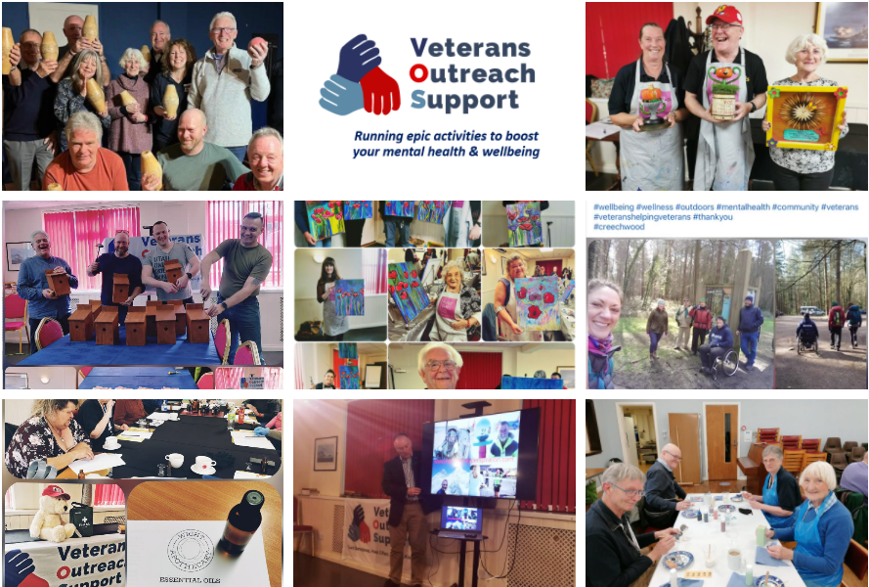
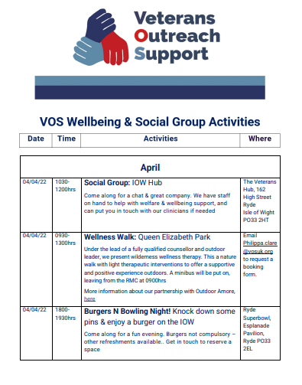
Wellbeing - Activities

Slide 10
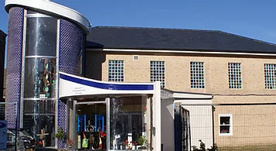
Our Drop-In Locations
Royal Maritime Club, Portsmouth
Congregational Church, Newport

Slide 11
Other Partners
Portsmouth Military Mental Health Alliance
Covenant funded services
Positive Minds
Solent recovery college
Veteran Substance Misuse
Service family provision
VOS, Solent Mind, CCG
Solent AF Covenant Partnership Board
Drop-In partnership
Soton, Gosport, IOW, Portsmouth
Wider collaboration
Solent needs analysis
Portsmouth Hospitals Trust
Veteran Aware campaign
New AF Covenant Lead Nurse
Coffee, Cake, Companionship
Quarterly meetings
Advice to DMWS (discharge)
Monthly roadshows (VOS, Age UK)
Notes:
Health/Clinical Support
Team: Rob Jackson is our new clinical lead.
Alcohol advisor available (being recruited). Combat Stress is present – John Bromley
Solent NHS Trust.
Talking Change provides a range of therapies for those dealing with common MH problems – depression and anxiety. Talking therapy incl CBT, Mindfulness and EMDR (Eye Movement Desensitization and Reprogramming)
Tracey is our POC on the the ACHT with links into the Criminal Justice Liaison and Diversion team.
SCVS is funded by the NHS as one of 10 specialist services set up nationally. They provide assessments for all MH needs but don’t treat – they refer to other NHS services and/or mil charities.

Slide 12
Our Service Users
MN
(2%)
RAF
(10%)
RM
(5%)
Female
(27%)
Army
(48%)
RN
(35%)
Male
(73%)

Slide 13
Our Service Users – Age
78% of VOS Service Users
Are aged 41 and over
25-40
(21%)
Over 55
(49%)
1% of VOS Service Users
Are aged 25 and under
41-55
(29%)

Slide 14
Our Why?
“Since coming to VOS and receiving all the treatment and support there, he just keeps going forward and getting better. There’s still more we all need to work on. But I am seeing the man I fell in love with again. VOS has given me my husband back.”
Mrs Lexie Shepard

Slide 15
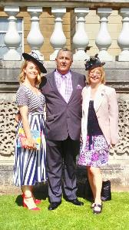
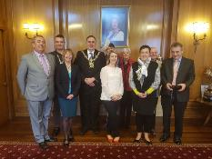
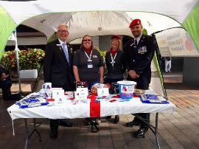
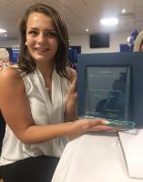
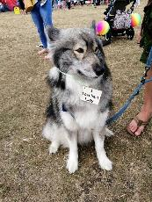
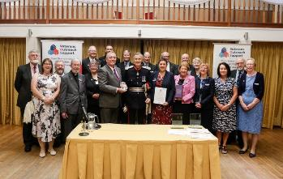
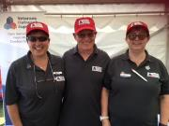
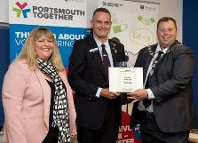
Our How
52 volunteers in Portsmouth and IOWW as at 4 May 2022 – and growing

Slide 16
Our Lessons
Demand for veteran-specific services remains strong
The social aspect is fundamental.
Support is most effective when it’s holistic
The ‘one stop shop’ model really works
Veterans want help, not just “signposting”
Agencies are good at collaborating, and want to
Mental health support is best if it’s immediate
There’s lots of help available – just need the keys! - VPPP

Slide 17
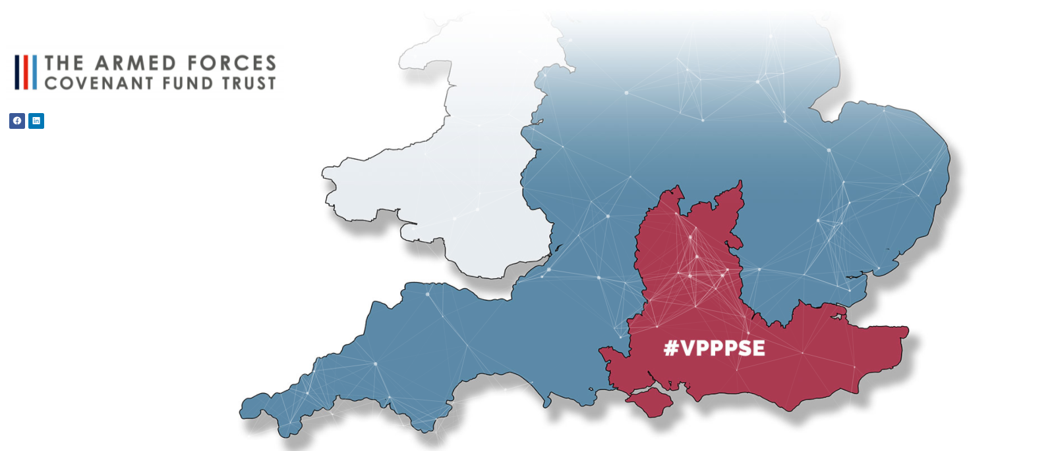
Our Future (VPPP) ‘Partnership in Mind’
A Network of service providers across the region, linked by a common goal of improving the lives of veterans in need.
Multiple points of entry into the support network: No wrong door

Slide 18
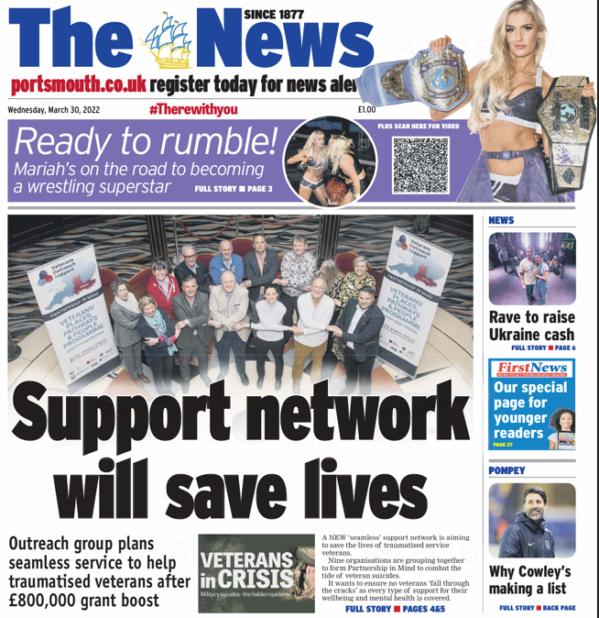
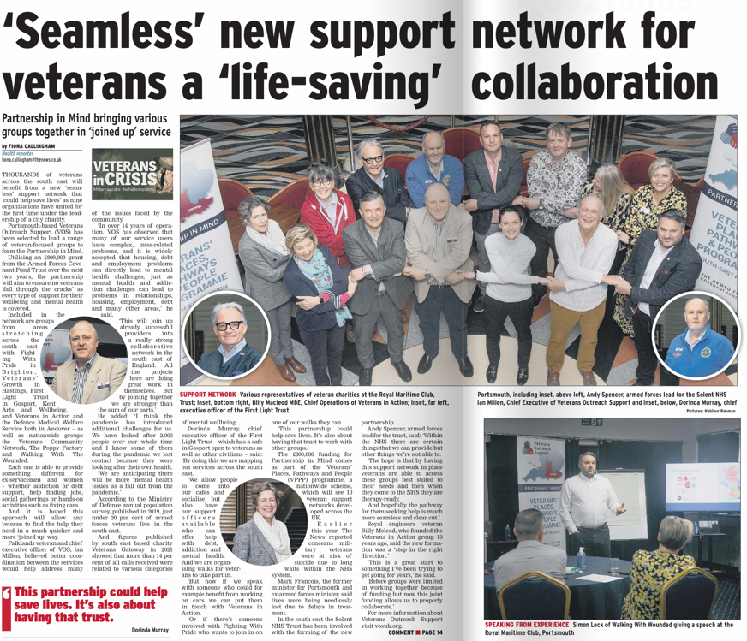
30th March 2022 The News

Slide 19
Veterans Outreach Support
ASDIC Conference 2022
Royal Armouries Leeds
Ian Millen – Chief Executive
Notes:
Welcome and introductions

