Slide 1
NHS England Armed Forces community health update
Richard Swarbrick
Head of AF Strategy and Partnerships, NHS England
May 2022

Slide 2
The Health and Care Bill
Commissioning healthcare for serving members of the Armed Forces and their families registered with Defence Medical Services, veterans’ mental health services and prosthetic services will remain with NHS England
Commissioning healthcare for veterans of the Armed Forces and their families registered with NHS GP practices will remain with integrated care systems (ICS)
Discussions with the 42 ICSs are underway to explore how we as co-commissioners of healthcare for the Armed Forces community will work more effectively for this population
Demonstrate ‘Due Regard’
Improve population health and healthcare
Tackle unequal access, experience and outcomes
Enhance productivity and value for money
Ensure the NHS supports broader social and economic development

Slide 3
Armed Forces policy and strategy

Slide 4
Supporting veterans’ health and wellbeing needs
Commitments
We will expand our support for all veterans and their families as they transition out of the Armed Forces, regardless of when people leave the services.
To ensure all GPs in England are equipped to best serve veterans and their families, over the next five years we will roll out a veterans accreditation scheme in conjunction with the Royal College of GPs.
Commitment 5
Improving veterans’ and their families’ mental health

Slide 5
A complete veterans mental health care pathway
The Veterans Mental Health and Wellbeing Service
Veterans’ Mental Health
Transition, Intervention and Liaison Service (TILS) 18,534 referrals from April 2017 to Jan 2022
Veterans’ Mental Health Complex Treatment Service (CTS) 2,413 referrals from February 2018 to Jan 2022
Veterans’ Mental Health High Intensity Service (HIS) 912 referrals from Sep 2020 to Jan 2022

Slide 6
Op COURAGE – reflections over the last year
Launch of Op COURAGE at last year’s King’s conference ➔ 25% increase in referrals the same week
Additional £4.1m invested for Op COURAGE to support veterans impacted by events in Afghanistan, as well as military police and interpreters working with the UK Armed Forces in Afghanistan. This includes:
clinical assessment and treatment plan development
care co-ordination of complex cases
access to drug and alcohol misuse services
translator services
Op COURAGE fully operational across England (East of England HIS launched this Monday)
Ongoing funding awarded to Armed Forces charities to enhance veterans care, ie social prescribing
“The treatment I received was a very positive experience for me – the team understood my situation and I genuinely and readily engaged with it.
I wish that I had been referred earlier to a veteran specific service as only those who have been in the military really understand.”
Op COURAGE service user

Slide 7
Improving support for veterans’ families
“It wasn’t just me though, they involved my wife, made her feel like part of the team and that she was important too. She’s now linked in with other people who understand her and what she’s going through too.”
Op COURAGE service user
Commissioning of an Integrated Care Board based Armed Forces families / Armed Forces community single point of contact:
Will act as a point of contact for Armed Forces families / the Armed Forces community, providing support and guidance to navigate the NHS to help prevent disadvantage
Will include supporting the families of veterans accessing OP COURAGE
To be informed by three pathfinder services that are already running for 18 months from April 2022
First families already using the services
“HIS were a lifeline. They helped me and my son find somewhere to stay so I could get things sorted.”
Op COURAGE service user

Slide 8
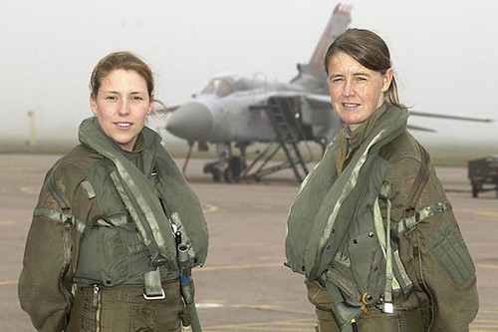
Serving and ex-service women priorities
Prevention and lifestyle
Mental health pathway
Maternity pathway
Domestic and sexual violence
SESW in the criminal justice service
Employment after service
Research

Slide 9
Improving support for veterans in the criminal justice system
Refreshing the health needs of the Armed Forces veteran population that comes into contact with the criminal justice system (CJS)
Reviewed all existing veteran CJS services, including referral pathways and interfaces
Partnership arrangements in place with stakeholders and third-party providers of veteran specific services
Designing a single CJS pathway for veterans, informed by lived experience, to commission a future service
Planning engagement with wider stakeholders to inform the future service model

Slide 10
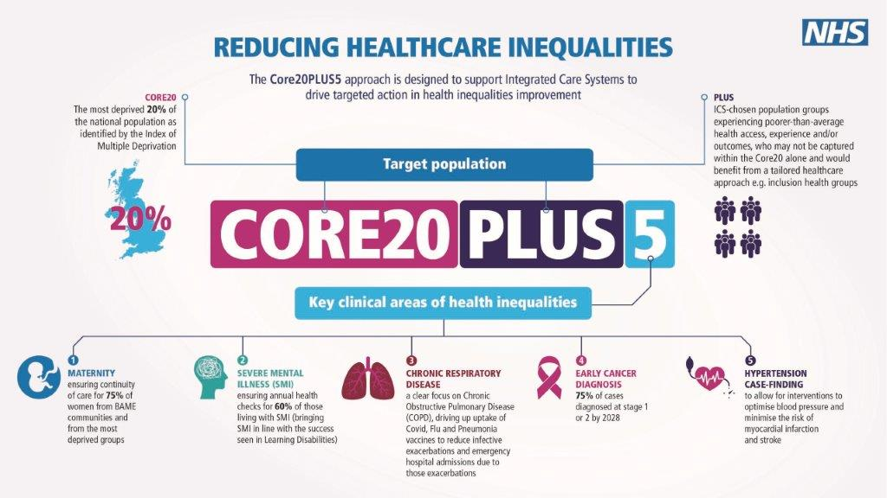
Our approach to reducing inequalities – the ‘Core’ and the ‘Plus’ apply to the Armed Forces community
Armed forces population experiencing poorer than average outcome not captured by Core20 and would benefit from a tailored healthcare approach

Slide 11
Partnership working to enhance veteran and AF community care
Ongoing collaboration and partnership working with Armed Forces charities to provide:
holistic care and support for veterans
enhanced care co-ordination for veterans
face to face care during the pandemic
Military charities represented on programme Boards and involved in commissioning processes
Ongoing collaboration with cross Government departments to inform policy and drive improvements in veterans care
Strong Cobseo and wider connections
Crucial role of ASDIC and local drop-in-centres

Slide 12
Supporting veterans into NHS employment
Step into Health, developed in conjunction with The Royal Foundation and Walking with the Wounded, provides a dedicated NHS career pathway for the Armed Forces community
Through Step into Health, individuals can connect to NHS organisations to access work placements, attend insight days, receive job application support and apply for jobs
Programme encourages NHS organisations to make full use of the skills, knowledge and experiences of the Armed Forces community
To pledge to the programme, NHS organisations sign a pledge certificate which commits them to five mandatory pledges
112 NHS organisations have pledged their support to the programme, with over 1,570 individuals employed to date
Notes:
There are five mandatory pledges that all organisations joining the programme have to commit to. These are:
reviewing recruitment practices and removing any barriers to recruiting members of the Armed Forces community
sharing dedicated Step into Health contact details
building a relationship with the Career Transition Partnership (CTP)
using the Step into Health branding to promote consistent messages about the programme
using the Step into Health candidate system to record interactions with potential candidates and to refer between NHS organisations as required.

Slide 13
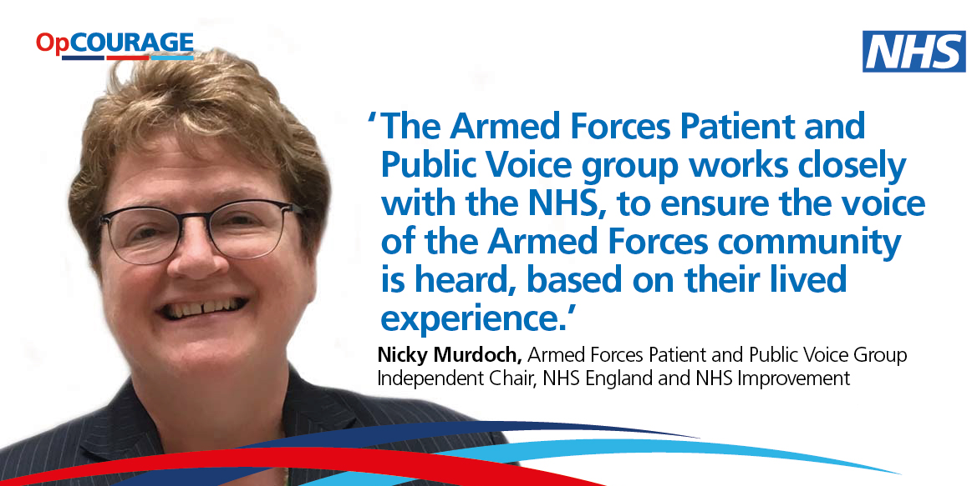
Lived experience – a golden thread
NHS England Armed Forces Patient and Public Voice Group champions the views of the Armed Forces community
Patient, service user and family / carer involvement in all work programmes and commissioning activity to ensure the voice of the Armed Forces community is heard
Proactively captures patient and service user feedback to inform service improvements
Works with clinicians to share patient insights and inform care provision
Informs and supports communications and engagement activity

Slide 14
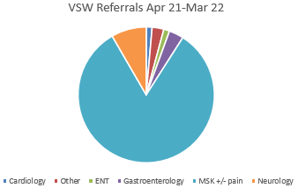
Veterans Trauma Network (VTN)
The VTN provides specialist care and support for veterans who have a physical health need from their time in the UK Armed Forces.
The VTN uses a network of clinicians across England who have a military background and/or understanding of the military who work closely with GPs, specialist services such as NHS OpCourage and military charities to support the veteran.
Veterans are eligible if they have a service-related physical health problem as a result of their time in service – no matter when they left the UK Armed Forces.
All veterans have a consultant-led multi-disciplinary team review of their service-related physical health need and are referred on as clinically appropriate by the VTN.
Veterans are offered further holistic and welfare support via a Veteran Support Worker provided by a military charity (DMWS) which can also help their family access appropriate support services.
For further information or make a referral, please contact ENGLAND.veteranstraumanetwork@nhs.net

Slide 15
How the NHS is supporting veterans
21,800+ referrals to Op COURAGE
70%+ ex-Army and 90%+ white males, of whom nearly a third are 31-40
340+ referrals to the Veterans Trauma Network
Over the last year, 96% of referrals have been men, the majority of whom (46%) are 43-62. 80%MSK +/- pain
Veterans Trauma Network
1,250+ veteran friendly GP accredited practices North East and Yorkshire (33%) and the Midlands (25%) have highest percentage of accredited practices
100+ Veteran Aware accredited trusts Aim is to accredit all trusts by March 2023
1,570+ veterans employed through Step Into Health 112 NHS organisations have pledged their support to this programme
Notes:
Impact of recent events in Afghanistan:
Varying impact on Op COURAGE referrals, with referrals in London and the South East doubling, whilst other regions are more stable.
Increase in visits to the Op COURAGE pages of the NHS website (up from 375 visits w/c 2 August to 2,333 visits w/c 16 August)
Significant push to promote Op COURAGE has led to increased social media activity and sharing of info / signposting to service

Slide 16
What next for veterans’ mental health
Enhanced annual investment of £21m+
Commissioning of first ever integrated veterans mental health service in England - OP COURAGE: The Veterans Mental Health and Wellbeing Service
Service will deliver a single point of entry and a clinical pathway that provides a comprehensive mental health service, based on individual clinical need and evidence based care. This approach ensures individuals have care and treatment that is flexible to respond to their changing mental health needs at various stages of their care – will go live from April 2023
The service will meet the following as agreed by the National Quality Board:
Respect for patient-centred values, preferences and expressed needs
Proactive involvement of family and friends
Information, communication and education
Coordination and integration of care
Physical comfort and emotional support
Transition and continuity
Access to timely care

Slide 17
What next for veterans’ mental health
Associated engagement launching this spring to inform new clinical model of care
For the first time, the engagement will also explore the physical health needs of veterans to shape improvements in holistic care provision
Other areas that will be explored, include the health needs of:
families and carers of unwell veterans
veterans struggling with drug, alcohol and gambling addictions

Slide 18
Support for Ukraine
A national effort is underway to provide support to Ukraine and to ensure the NHS stands ready to provide further support as needed
As part of this, outreach and support is being mobilised for veterans impacted by events in Ukraine, as well as for those from the Ukraine and Armed Forces personnel
Wider NHS help and support is being co-ordinated via national emergency planning, preparedness, resilience and response routes

Slide 19
Thank you and questions

