Slide 1
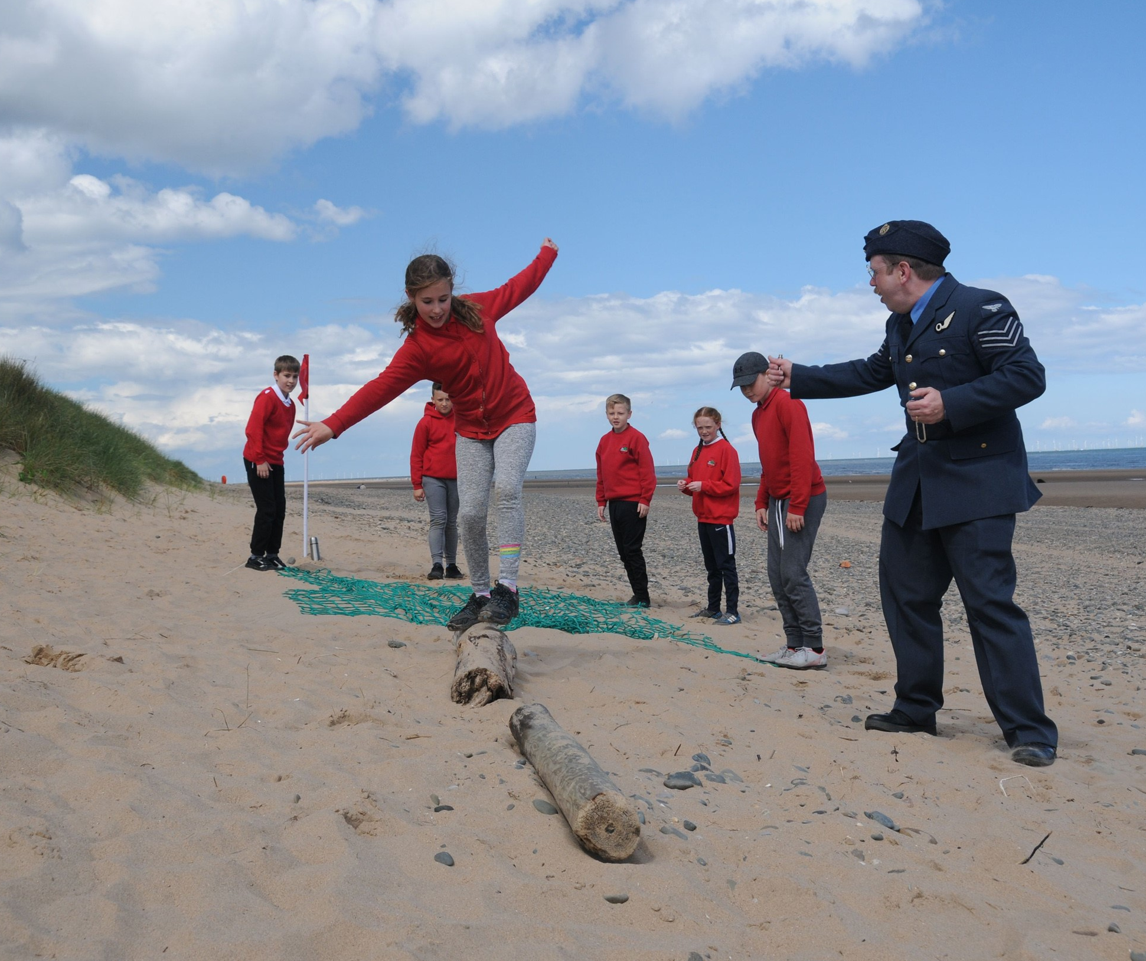
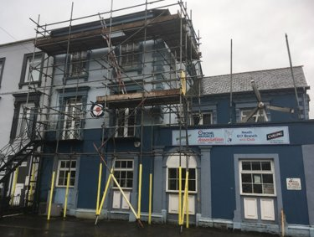
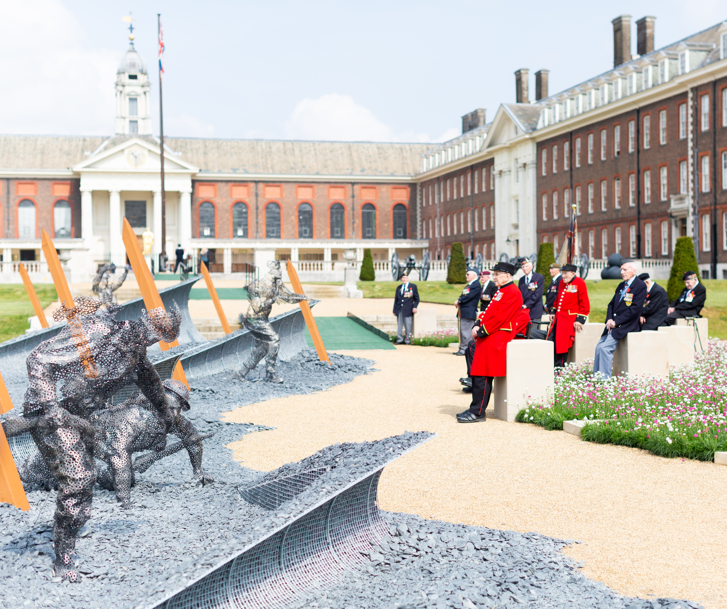
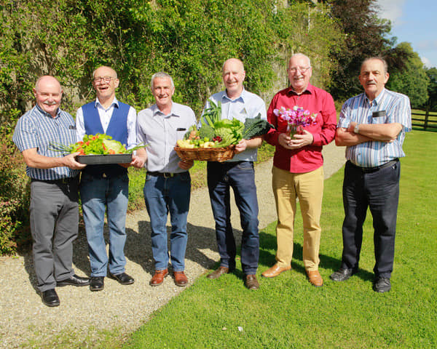
Supporting the Armed Forces Covenant through funding real change
ASDIC Conference 2022
Notes:
Good Afternoon ladies and gentlemen and thank you for inviting me to offer an update from the Trust

Slide 2
Who we are
The Armed Forces Covenant Fund Trust (the Trust) supports the Armed Forces Covenant by delivering funding programmes that create real change to Armed Forces communities across the UK.
4 broad funding themes now and in future years.
1. Non-core healthcare services for veterans.
2. Removing barriers to family life.
3. Extra support, both in and after Service, for those that need help.
4. Measures to integrate military and civilian communities and allow the Armed Forces community to participate as citizens.
We also work with HM Government to run other funding programmes that have a positive impact on Armed Forces communities.
Notes:
For anyone around the table who is new I thought I’d just quickly offer some brief background about our organisation. We are a charity and are classified as a Non-Departmental Public Body, or NDPB. We look after the Armed Forces Covenant Fund, worth £10M each year. We have 4 broad themes that underpin all of our funding programmes.

Slide 3
Notes:
These are recent funding programmes that the Trust has delivered. The Veterans Mental Health and Wellbeing Fund of £30M, funded by the Treasury, spanned a period of 3 years, whilst the Afghanistan Veterans Fund of £5M was delivered within 6 months.

Slide 4
In 2021/22 The Trust funded over 500 projects to support Armed Forces communities; awarding £25M This year; we are keen to
Fund
Fund projects that address specific needs within Armed Forces communities
Explore
Explore how we can support projects that address hidden and compelling needs; to deliver sustainable long term change
Encourage
Encourage people to get involved with the work we are supporting through the Veterans Places, Pathways and People programme
Share
Keep sharing the learning from our projects, and help this to reach wider
Notes:
Through the different funds that we manage; we make a significant number of grants
Notwithstanding the high volume of grant making the organisation’s grant assessment and management processes are extremely thorough, with grant making excellence as standard. It is our aspiration to develop our processes externally also to increase engagement with the military charity sector and beyond in order to more thoroughly understand the landscape of need and the direction of travel.
These are four important priorities for us this year

Slide 5
Put the new programmes graphic here
Notes:
These are the Covenant Fund programmes that we are running this year
The Force for Change and Reaching and Supporting Armed Forces Communities grant programmes are open now
The Transformational grants programme will launch later this summer

Slide 6
Grants of up to £100,000
For projects addressing hidden, compelling or complex needs
Be specific about who the project will benefit; and what their needs are
Develop your project ideas with the people who will benefit from any project
Think carefully about long term impact
Charities and CICs can apply
Notes:
This is a programme that will fund projects that will deliver significant changes or improvements for Armed Forces communities where there are hidden or compelling needs. We want to hear from those who know the most about what is needed and that’s why this year we are running such a broad programme.
If you apply for a grant, you need to show how this would help to address hidden, compelling and complex needs, for specific and identified beneficiaries, in a meaningful way, and where evidence has highlighted gaps in support and provision
Hidden and compelling needs
We use the terms ‘hidden’ and ‘compelling’ to describe some complex needs that some people in Armed Forces communities experience.
A hidden need would be a less well understood or emerging need within Armed Forces communities, where a grant would make a significant difference. This could include projects for specific groups within Armed Forces communities who have not previously been able to access any sort of help, including charitable support or funding.
A compelling need would be a challenging and pressing need within Armed Forces communities which has a significant and limiting impact on a person's life. Projects looking at compelling needs might be looking at issues that are well known within Armed Forces communities, but where a specific and targeted project would make a significant and lasting difference.
We are looking for projects that are specific and targeted, rather than taking a generalist approach.
We are also looking for applications that can be clear about the evidence of why their project is needed, and how the impact of the project will continue after the grant has ended.
Your application should explain why the hidden or compelling needs that your project will address require resource, and explain the difference that this will make to people’s lives.
We will consider projects that support serving personnel and/ or their families or veterans and their families. The grants that we have previously awarded which support serving personnel have only had limited reach to Reservists. We would be therefore be particularly interested in project proposals that would support specific needs faced by Reservist personnel and their families.

Slide 7
Types of sustainability: how a project sustains beyond the life of a grant
Accessing finance for ongoing delivery
Ongoing partnership and collaboration
Ongoing improvement for project beneficiaries
Improved knowledge and evidence
Notes:
This year we have a very strong focus on sustainability and will be inviting applicants to tell us in what ways their project will have sustainable outcomes that go beyond the life of their project.
We recognise that these MIGHT require accessing finance for ongoing delivery. However, they may also leave a legacy of ongoing partnership and collaboration, ongoing improvements for beneficiaries or improved knowledge and evidence for future work.
You’ll need to tell us about the type of long term changes that you expect your project to have

Slide 8
Grants of up to £10,000
Charities, CICs, Local Authorities Health Bodies and schools can all apply
Your project will need to
Address a specific need for Armed Forces communities within your local area
Be able to be completed within a year or less
Be able to show that the people from Armed Forces communities that your project will work with have helped to design the project, and would take part if you received funding
Notes:
Through this programme, we fund projects which make a real difference to Armed Forces communities locally. We will support projects that offer support to Armed Forces communities to help with needs that may not have been addressed in the past. This can also include funding for pilot projects; or to try new ways of offering local support. It can also include projects that build on earlier work that you have done
This year, we’ll support ideas that need small amounts of funding to deliver changes or improvements for Armed Forces communities. We want to hear from those who know the most about what is needed and that’s why this year we are running such a broad programme.
If you apply for a grant, you need to show how this would help specifically help to address compelling or specific needs in a meaningful way; and where you can clearly tell us about the current gap that exists in provision and why this project might help.
Your project will need to
Address a specific need for Armed Forces communities within your local area
Be able to be completed within a year or less
Be able to show that the people from Armed Forces communities that your project will work with have helped to design the project, and would take part if you received funding
There are three rounds of funding that we are running this year, and all of the guidance is on our website

Slide 9
Notes:
With funding from HM Treasury, we have awarded £9m to some very exciting projects
The Veterans Places People and Pathways programme is seeking to make improvements to enable veterans to access support that meets their needs. Funding will encourage the development of safe, welcoming places for veterans to go in their local area, support for the people; (staff and volunteers in organisations that support veterans) to be able to have access good quality training and have better access to connect veterans into wider pathways including for mental health support and treatment.
10 grants have been awarded in the countries and regions of the UK, to develop better, more joined up lasting support for local veterans with mental health needs; 4 grants have been awarded for national strategic projects. (which includes funding to ASDIC)
10 Portfolio grants have been awarded; with one each in Scotland, Wales and Northern Ireland with seven regional grants awarded in the UK. Across all of the portfolios; 170 individual projects will be supported.
Each grant has been made to a lead organisation that will co-ordinate a dynamic and co-ordinated portfolio of projects that will take an informed approach across their country or region. They will ensure that there are connected pathways which work well for veterans; that there are safe places for veterans to go which connect into these pathways; and that volunteers and staff who support veterans have access to training and work closely with other organisations within veterans’ mental health pathways.
Grants have been awarded to Cobseo (the Confederation of Service Charities); the Association of Service Drop-In Centres (ASDIC); SSAFA and Combat Stress. These Strategic Leads will work within the wider Veterans Places, Pathways and People programme, and with a cross-sector Oversight Group to encourage the integration of existing clinical mental health provision with the broader non-clinical services for veterans needing general wellbeing support as well as those on the mental health recovery pathway across the sector. Their work will strengthen the development of more joined-up local provision for veterans.
These specialist organisations will work with the 10 Country and Regional portfolios that will be supported through the wider programme; with the wider Armed Forces charitable sector; and with organisations that support veterans.
I think that a number of you are already involved in the work of these portfolios; but if you are not, do try to keep an eye on their work as it develops in your country and region; and get involved if you can

Slide 10
Why we have a focus on impact and evaluation

Slide 11
It ensures that our funding programmes make a real difference to veterans, Armed Forces families and the wider Armed Forces community.
By using learning from existing funding programmes, it helps us to run stronger and more effective programmes in future.
Understanding the impact of their work can help the projects that we support to become more sustainable
We can share learning and good practice ideas from projects that have made a big difference.
Notes:
We see evaluation as vitally important in terms of measuring the impact on the Armed Forces community, informing the design of future programmes, helping us to understand sustainability and to share the learning of what works.

Slide 12
Evaluation reports
Our Knowledge Network
Case studies
Topical papers
Map of Need resources
Annual reports
Local Authority good practice resources
Notes:
Our Knowledge Network is where we store information from the projects we’ve funded. It’s a growing collection of reports, tools and good practice information

Slide 13
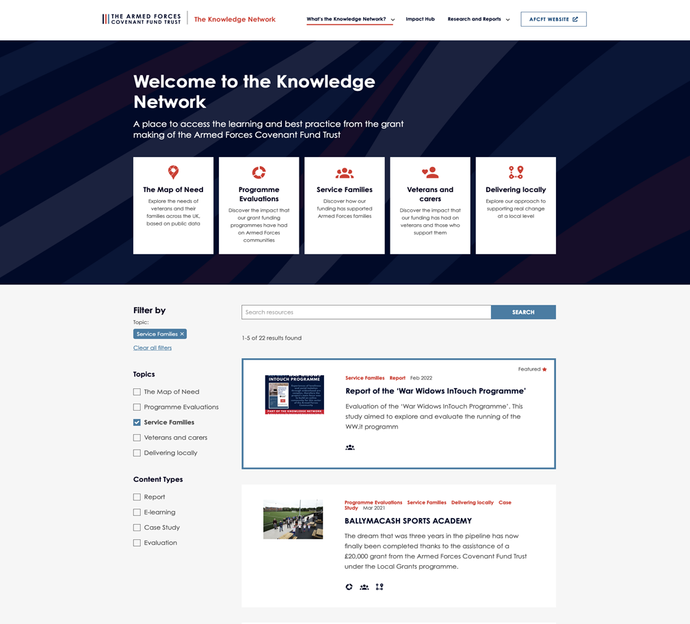
https://covenantfund.org.uk/resources/
Notes:
The Knowledge Network is an open access data repository created by the Armed Forces Covenant Fund Trust.
It features impact and outcome based content from both the programmes the Trust delivers and the projects we support.
The Knowledge Network is a growing collection of curated content for those working with and supporting the Armed Forces community and features research, reports, evaluations, case studies and e-learning to help showcase the best practice and positive outcomes achieved.

Slide 14
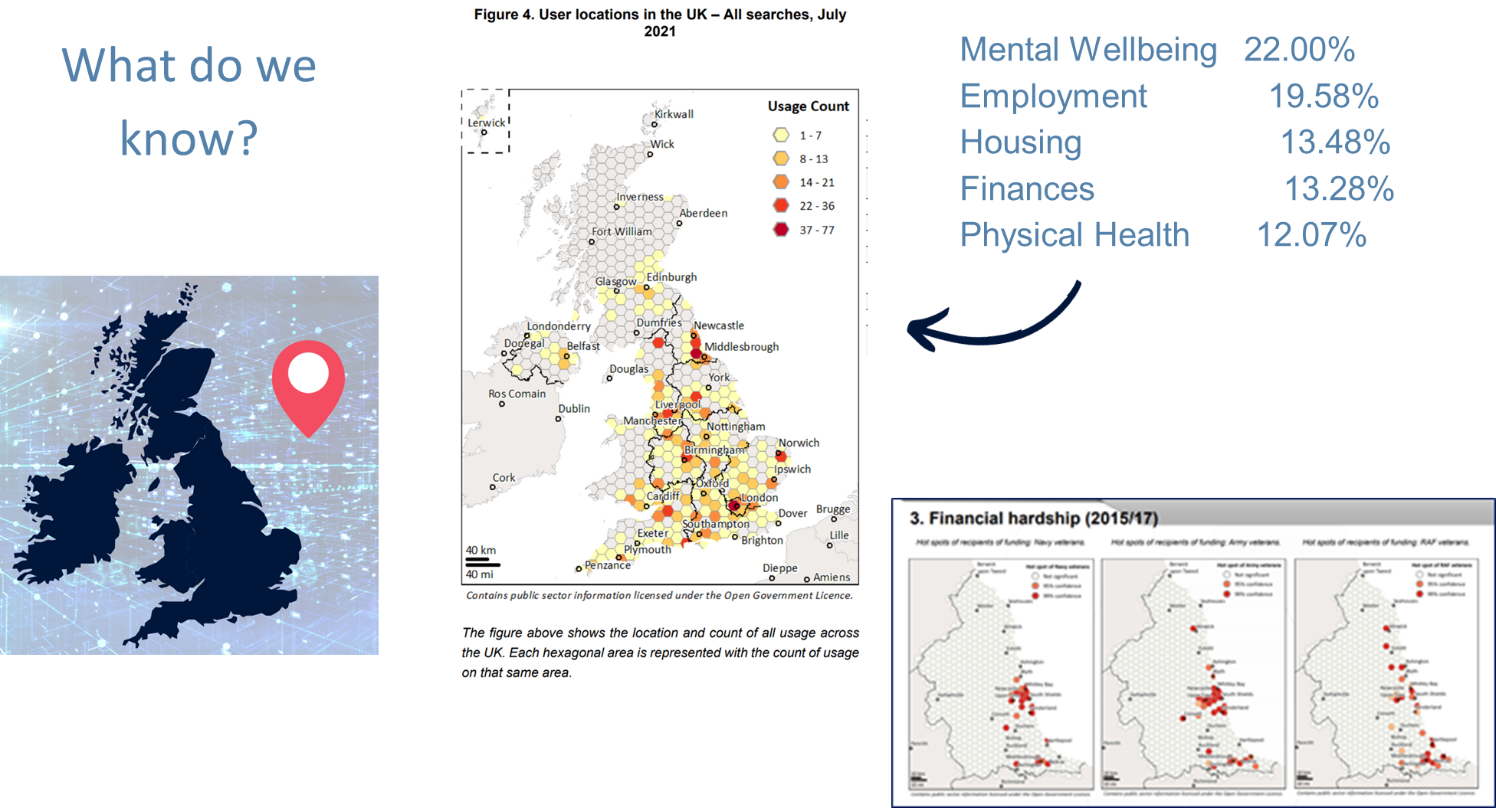
Notes:
With an initial grant from us of £500,000, the Northern Hub for Veterans and Families Research at Northumbria University used funding from the Covenant Fund to develop a map of veterans’ and their families’ welfare needs across the whole of the UK, based on data from public sources, statistics, health data and data directly from Armed Forces charities.
We awarded additional funding to expand the Map of Need to include data relating to Armed Forces families. You can explore the findings from this major project on the Knowledge Network; and it may give you additional insights into the

Slide 15
Projects innovated
TO RESPOND TO THE CHALLENGES OF COVID 19
What do we know?
Projects wanted to adapt their work
There was a digital shift; how will this sustain (and better support beneficiaries)?
Organisations able to mobilise quickly; and show clear evidence of need
Significant reach of projects
Notes:
We also have information from other programmes and projects that we funded. Many veterans drop in centres accessed funding through our specific Covid Impact related programmes. These were the key findings from that evaluation.
The Veterans Should Not Be Forgotten programme awarded 120 grants to organisations across the UK, totalling £2,394,698.
Our programme evaluation explored the impact of the Veterans Should Not Be Forgotten programme on vulnerable veterans with reduced social contact.
Funding was available for up to £20,000 per organisation, for a six-month project.

Slide 16
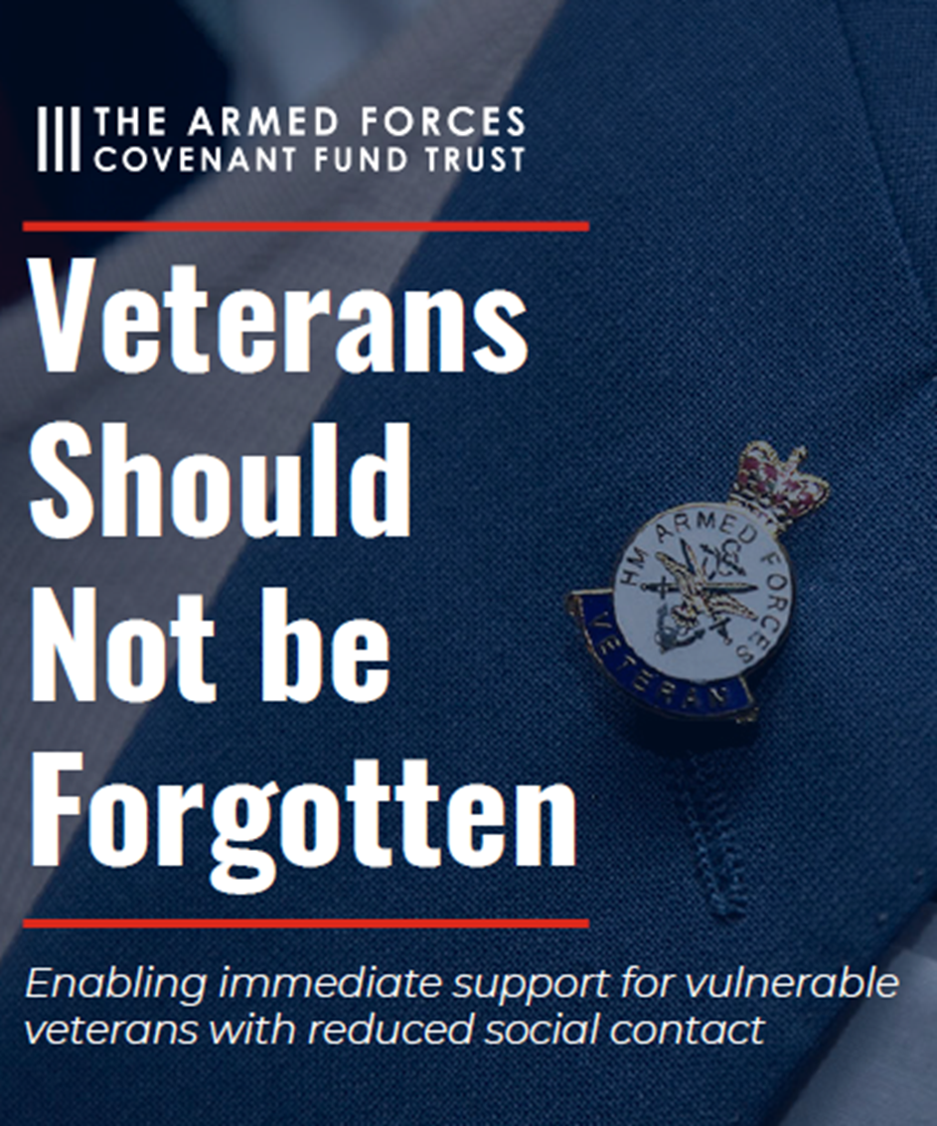
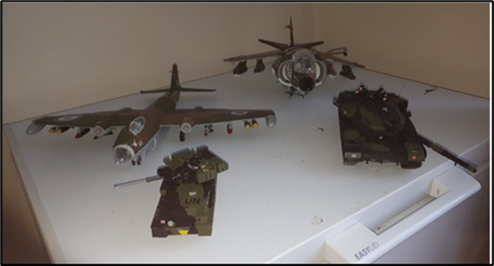
Veterans' Support Association
VSA Hobby Packs
Awarded £5,000
“We wanted to give people something to do when they had nothing”
Notes:
I’d like to finish by highlighting a small grant that made a big difference
The Veterans' Support Association received a grant of £5,000 as part of the Veterans Should Not be Forgotten programme. In the six months that the project ran, the organisation spent the funds on projects or hobby packs for veterans to complete at home during lockdown. The project was a huge success as it kept veterans engaged and focused during the months that followed, as the country endured its first lockdown.
After lockdown hit in March 2020, the group set up a closed Facebook group for veterans, with the aim that they would all be able to ‘check in’ on each other and, more importantly, said John, “ensure that they got up every morning and found a reason to do so”. John; the founder of the group would send a message each morning with the words “Good morning brothers and sisters”, and each day he would receive 200 replies from group members. It soon became apparent from group posts that this safe space was a lifeline to many veterans who were struggling with loneliness and isolation as a result of the pandemic. As part of this interaction online, John and the other members started discussing hobbies – and then the idea came to him to apply for Trust funding to ‘send things to members’ – things that could be posted; perhaps a jigsaw, or a colouring book.
“We wanted to give people something to do when they had nothing,” quoted John. The only request that John and his team had when sending out the ‘hobby pack’” to their members was that they posted their progress online on the Facebook page. This way the veterans could share their achievements, be social and also promote the project’s activity to other users.
The Facebook page was soon alive with veterans sharing their hobbies with others – whether it be leathermaking, photography, or model making, which was extremely popular. “Sometimes the posts just exploded,” said John. “One guy would post a picture of his model and ask the others for the best glue to use, or something, and suddenly there would be hundreds of comments.” John reflects on the six months of the project: “We spent £800 per month, that works out at about £20 per veteran that asked us for help. It’s not a huge amount of money to keep a life intact and perhaps save a family.”

Slide 17
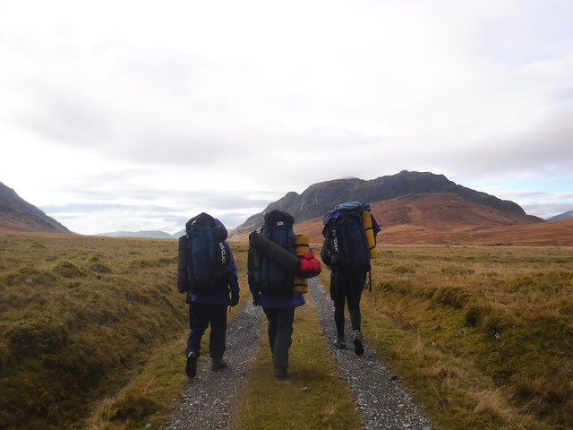
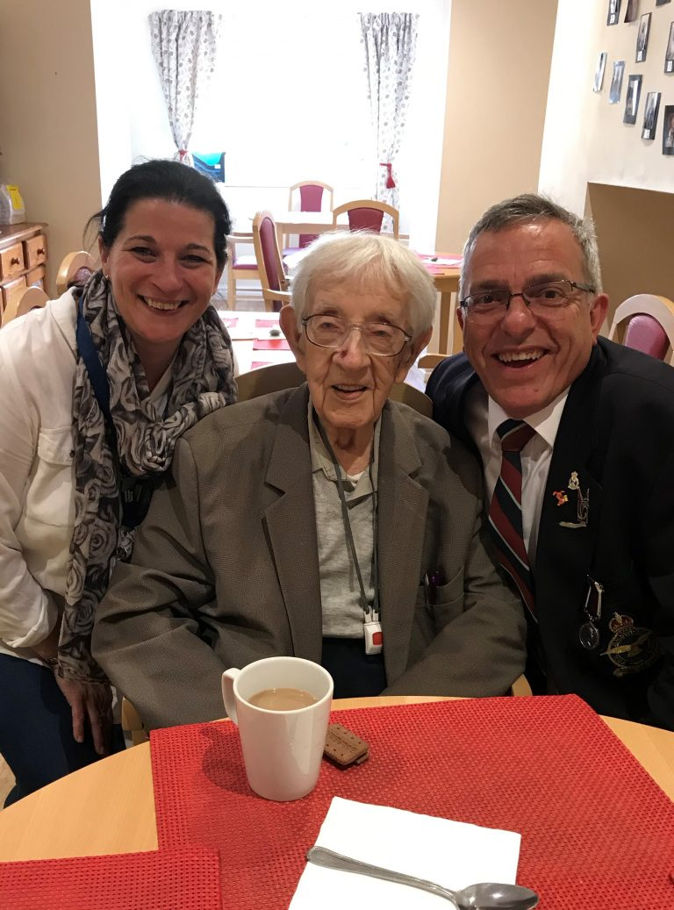
www.covenantfund.org.uk
Notes:
For information on all of our funding programmes, plus learning from projects we have funded, please do visit our website.
If you are thinking about applying for any of our programmes; you’ll be able to find all that you need
(these are all photos from projects we have funded…)

