Slide 1
Jim Wilson Veterans Scotland ASDIC Conference 4 May 2022
Notes:
Barry, many thanks for your introduction; I am delighted to be here and to address this audience. Veterans Scotland is an association of some 87 Service Charities and we seek to provide opportunities for those organisations to Collaborate, to Co-operate, to Co-ordinate and to Communicate in order to improve the delivery of their services. If you like, we seek to enable Mutual Support across all of those organisations that support veterans. I am not here speaking specifically on behalf of any particular one of those organisations, I do however recognise the important, indeed vital, part that a well developed network of Drop In Centres has to contribute to the well-being of many members of the ex-Service Community .

Slide 2
What is a Drop in Centre?
Definitions:
A place run by a welfare agency or charity where people may call casually for advice or assistance.
A Daycentre run by the social services or a charity that clients may attend on an informal basis.
Salvation Army: Different drop-ins may provide a number of services ranging from the practical – a shower, hot meal, warm clothes – to ‘surgeries’ run in the drop-in by specialist agencies such as outreach teams, drug and alcohol workers. Staff are on hand to help with basic housing and welfare enquiries and provide support with phone calls. Some drop-in services provide access to computers so that people can set up claims for Universal Credit or search for jobs. Other drop-in services will refer people for specialist legal advice.
The Drop-In Bereavement Centre: Provides ongoing help and support for bereaved individuals and families. It aims to assist them in coming to terms with bereavement. It seeks to help in making a real and sustained difference in the community. We are here to help you on your grief journey.
Notes:
Before lunch we considered what is meant by the term ‘Drop In Centre’ , and I show here some of the definitions I found while trawling through the internet. The emphasis is on being able to casually or informally call in for advice and assistance. Some may be very general and others can provide specific and tailored support.
It is not my intention to reopen the discussion on what a Drop in Centre is, however I feel that we must not underestimate the value that any individual will gain from knowing that there is somewhere that they can go to where they can get advice and support when they feel they need it.
The important thing is that what a Drop in Centre is, and what it should be able to deliver is very much driven by what a veteran or their family wants and by what the people that are providing the Drop in Centre are able to deliver – or aim to deliver.

Slide 3
Drop In Centres:
Drop in Centres may include:
Local Veterans Drop in Centres
Breakfast Clubs
Local Authority Day Centres
ERMAC Centres
Scottish Mens’ Sheds Associations
Veterans 1st Point
Armed Services Advice Project/Citizens Advice
Legion Scotland Clubs and Branches
Activity Groups
and more
Notes:
Here are some examples of organisations that a member of the ex-Service Community may go to in Scotland, if they need advice and support or indeed if they just want to take part in the activities that are available or to meet up with other veterans. Some are run by veterans charities, some are civilian charities, others are provided by local authorities and others are part of the NHS. The thing that they have in common is that in most cases you can just turn up when they are open and take part in what they are doing. This is important as it enables the veteran to establish a relationship and build their trust in the organisation and the people who are there.
An important characteristic of this group is that they are local and that they publicise when and where they are open. For the vast majority of veterans wishing to go to them for the social side of meeting other veterans this just confirms when and where to meet; however there is a small minority for whom the idea of stepping over the threshold into such a centre can cause anxious moments. They may wish to conduct a recce, to see what sort of people go there, to ‘case the joint’ before actually attending.
We occasionally hear stories of veterans who go and look at places several times before they have the confidence to step inside. This may, amongst other reasons, be due to a natural apprehension to meeting new people and trying to ‘break in’ to an established group; it may be because of uncertainty over the type of people that are there and how they might fit in – ‘Will it be full of Senior NCO’s when I was only a Lance Jack?’ or are they plucking up the courage to recognise that they have a problem and feel that subconscious urge to discuss it with someone but are not quite sure how to start?

Slide 4
Aspiration – Develop a Network
We identify a network of Drop in Centres where veterans may go.
The network should be available locally.
Services, advice and support should be consistent across those Centres.
Recognise that not all services are required all of the time, but should be available when needed.
Share good practice and information that veterans may require.
Drop in Centres can deliver significantly more benefit than their core purpose.
Notes:
So, how might we add value to the range of places and organisations that are already available? Certainly we should identify where such Centres are and how a member of the Armed Forces and Veterans Community may access them – support their advertising and promotion and ensure that other Services in the area are aware of them.
Recognising the local nature of such Centres is also important, how good would it be if we were in a position that every veteran knows about somewhere they could go within 5 miles or so of where they live? And if they need particular forms of support that it can be brought to them or they may be taken to where it is available?
Providing awareness about other services that may be available locally is important for these Centres, their own staff may not have specific expertise but they should know where it is available and be in a position to help when necessary – and be able to provide a ‘warm hand-over’ if required.

Slide 5
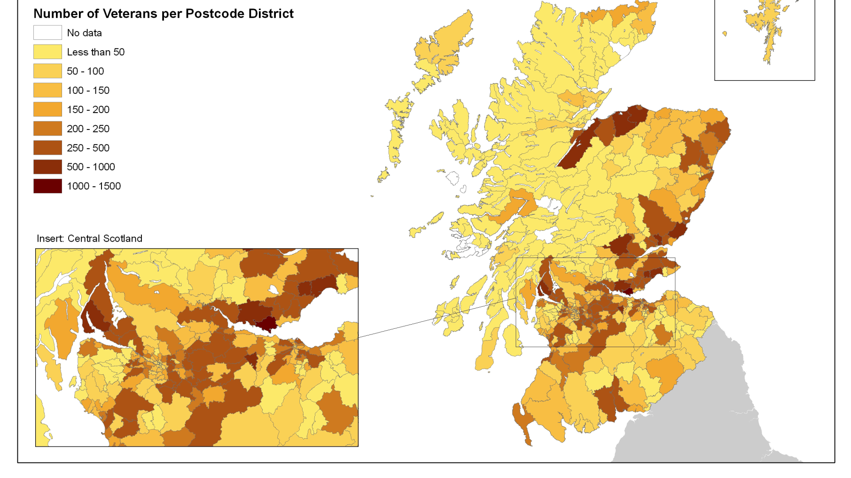
Where are Veterans in Scotland
Notes:
This slide is based on some research carried out by the Scottish Government and the MOD a few years ago but the picture it paints is most likely accurate. The darker the shading the more veterans live in the area, no great surprises that veterans live in the centres of population across the Central Belt and that they often choose to settle close to military bases hence the darker areas in Helensburgh and Rosyth, the Moray Coast and Inverness, Arbroath, Central Fife and the Edinburgh area.

Slide 6
The ex-Service Community in Scotland.
Perfectly well and healthy to severe disabilities and in need of constant care.
Aged 16 to 106.
Home owner to living on the streets.
In control of their lives to ‘in bits’.
Successful job to long term unemployed.
Educated to PhD level+ or education attainment level between 7 and 11.
Married, single, separated, divorced etc.
Notes:
You will have gathered that there is no such thing as a typical veteran; as this slide indicates, we will see all types of people who are veterans and the only thing that they have in common is the fact that they served for at least one day. The vast majority will have transitioned to civilian life without too many issues although we could expect some difficulty given that within a comparatively short period of time you could expect to move house, change job, look for a new school for the kids, new doctors, new dentists and such like, as well as moving into a community with which you may not be familiar and leaving a close knit community which spoke a common language and had, generally, similar roles whilst serving.
Most of the ex-Service community enjoy good health, both physical and mental; however we should not be at all surprised that some have those typical conditions that we are all susceptible to, particularly as we age. That said, veterans have a slightly higher incidence of muscular-skeletal injury and are slightly more prone to hearing loss; carrying heavy weights, hard manual labour and working with things that make loud noises this should not surprise us.
Being a veteran in itself, however, is not a condition!
So where are those veterans able to source support locally in Scotland? I should stress that the next few slides show locations where a veteran can attend as a Drop in Centre and I have not included the locations of those organisations that have staff who cover all of Scotland, such as the Veterans Welfare Service, SSAFA, Poppyscotland, Combat Stress and BLESMA or the various Regimental or Service Associations.

Slide 7
ASDIC – Existing organisations
Notes:
This slide shows dots where the existing members of ASDIC are in Scotland. Unsurprisingly they are very much located in the Central Belt. There is clearly room to increase membership of ASDIC and I anticipate this being pushing at open doors.

Slide 8
Armed Services Advice Project
ASAP
Notes:
This slide Shows the locations of Citizens Advice Bureaux that incorporate the Armed Services Advice Project. Each of these eleven locations can cover other CAB’s. Importantly, these centres can provide advice on matters linked to finances and debt, legal advice and family relationship advice. If there is not a dedicated ASAP office close to where the veteran lives, such advice can be obtained from any of the 59 CAB’s across Scotland. Their network covers all of the major towns and cities.

Slide 9
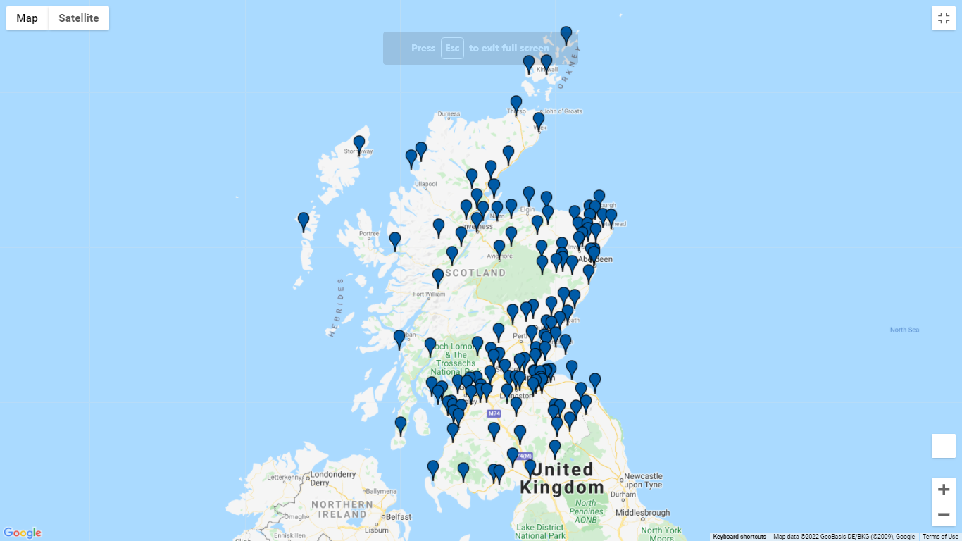
Legion Scotland Locations – Existing services
Notes:
The network of Royal British Legion Scotland Clubs and Branches covers all areas in Scotland.

Slide 10
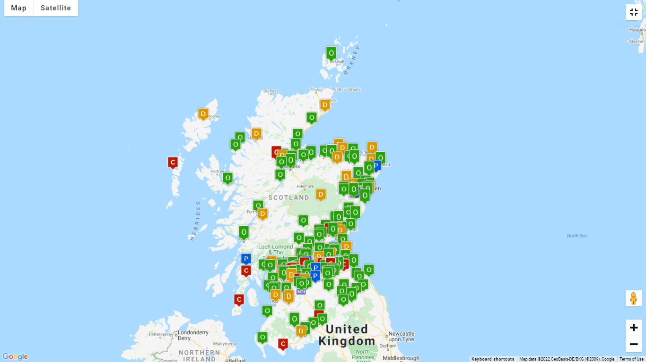
SMSA Locations (Open, In Development, Proposed or Closed)
Notes:
Whilst not a veterans charity, the Scottish Men’s Sheds Association Scotland are spread widely and provide activities, comradeship and company for many. As the name suggests, the organisation provides meaningful activities and whilst aimed at men from 55 and up is open to a much wider group.

Slide 11
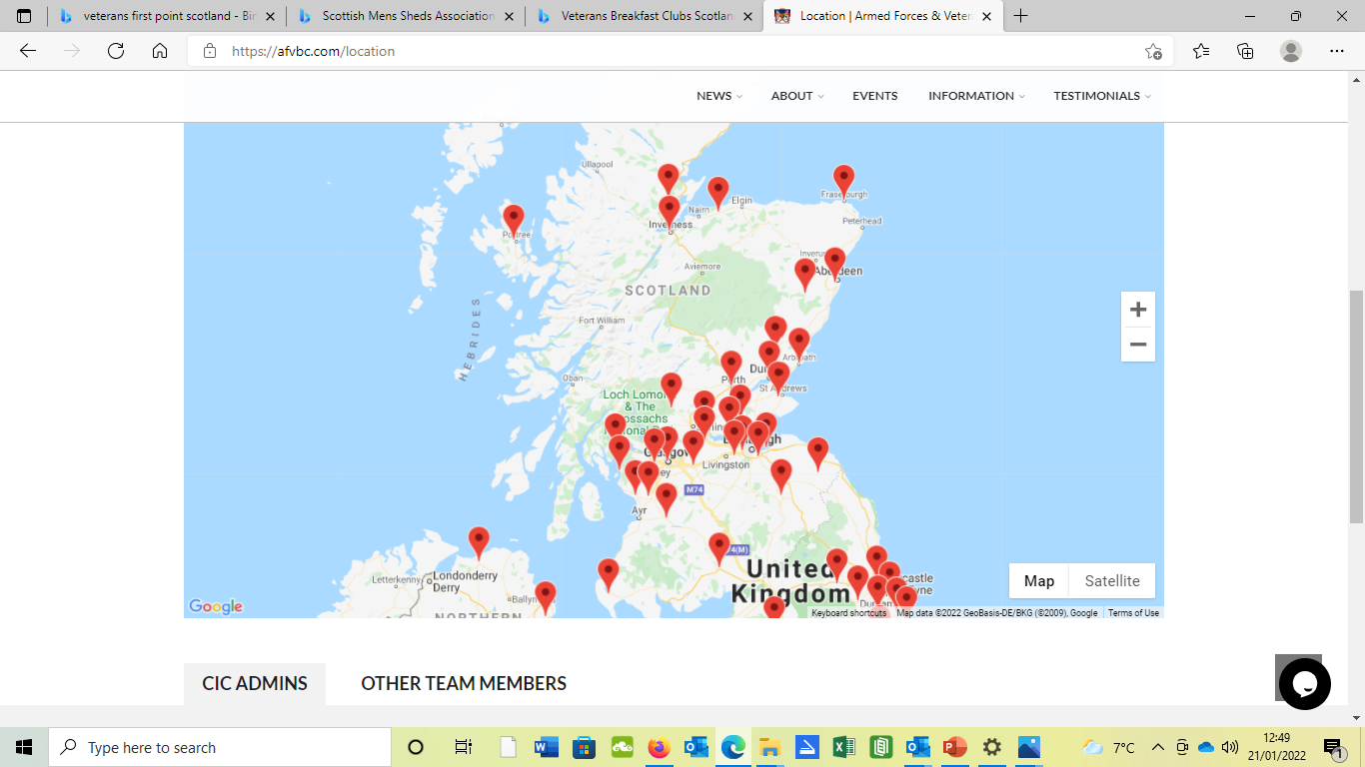
Breakfast Club Locations
Notes:
Veterans Breakfast Clubs have really captured the imagination and are taking off in many areas. Although a ‘once a month bacon roll and a brew’ may not seem significant they give an informal opportunity that attracts many.

Slide 12
V1P Locations – Existing services
Notes:
Veterans First Point is part of the NHS in Scotland and can be accessed without appointment. A veteran peer support worker will meet and greet, and have an initial discussion. If necessary, the veteran can then be assisted through mental health professionals.

Slide 13
Jim Wilson Veterans Scotland ASDIC Conference 4 May 2022
Notes:
So to sum up, within Scotland, there are currently many places that veterans and other members of the Armed Forces Community can go. There is a need to improve the consistency of advice and support a there is a need to ensure that centres are made aware of the more specialist support organisations that are available within the area.
I would like to see a situation where there is a drop in centre of some sort withing a 5 mile or so radius of all veterans and that more specialist support is available within a 25 mile radius.
I think I am just about out of time, but, Barry permitting, I would be happy to take a couple of questions and I am available for the rest of the afternoon….

