Slide 1
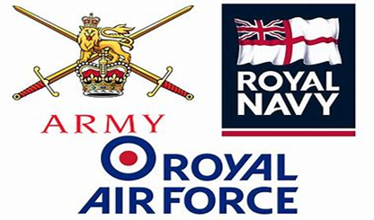
Veterans Covenant
Healthcare Alliance (VCHA)
Lieutenant Colonel (Retired) Guy Benson
Team Leader VCHA

Slide 2
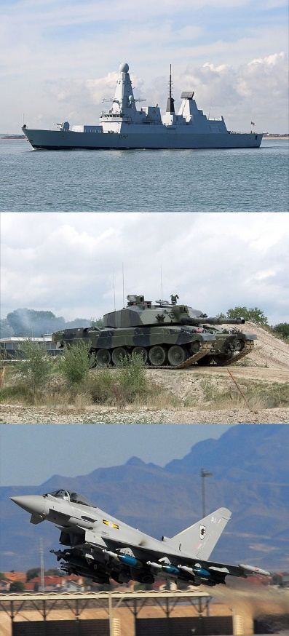
Scope
Introduction
Background
VCHA overview
Common Operating Picture
Summary
Questions

Slide 3
Why does our care for the Armed Forces community matter?
As set out in the Armed
Forces Covenant:
The first duty of Government is the defence of the realm
People who serve in the Armed Forces defend the realm, sacrificing some civilian freedoms, facing danger and sometimes, suffering serious injury or death.
Families play a vital role in supporting the operational effectiveness of the Armed Forces
In return, the whole nation has a moral obligation to the those who serve or have served, together with their families. They deserve our respect and support, and fair treatment.

Slide 4
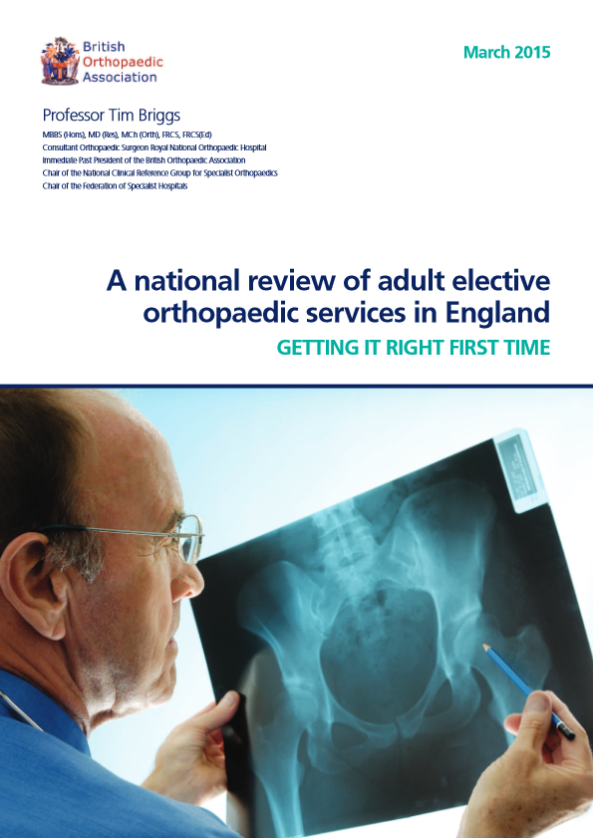
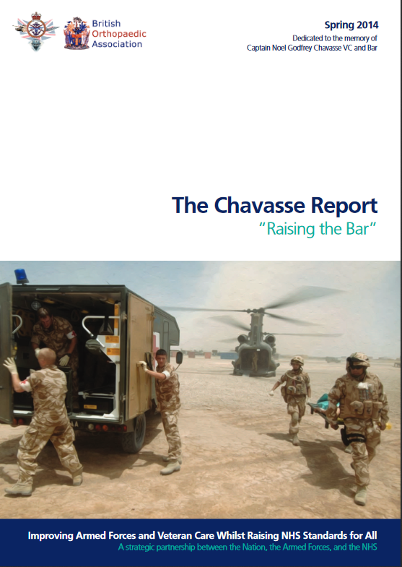
The origins of the Veterans Covenant Healthcare Alliance (VCHA)
1. GIRFT orthopaedic visits
2. The Chavasse Report
3. The VCHA Programme

Slide 5
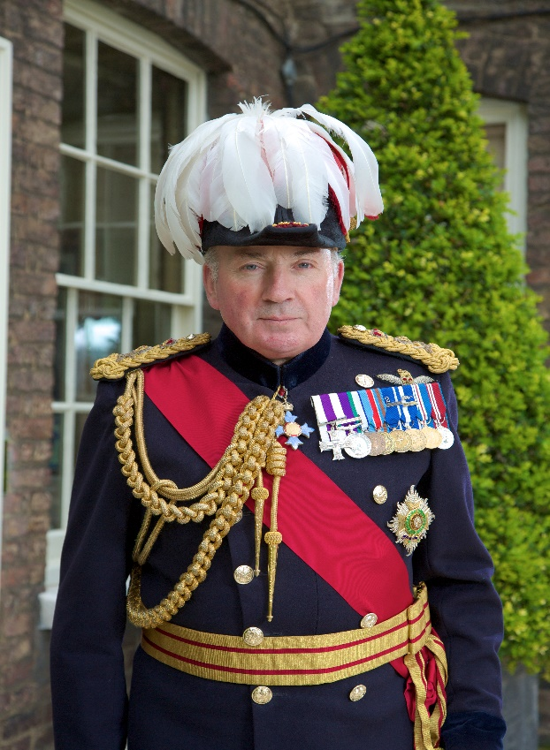
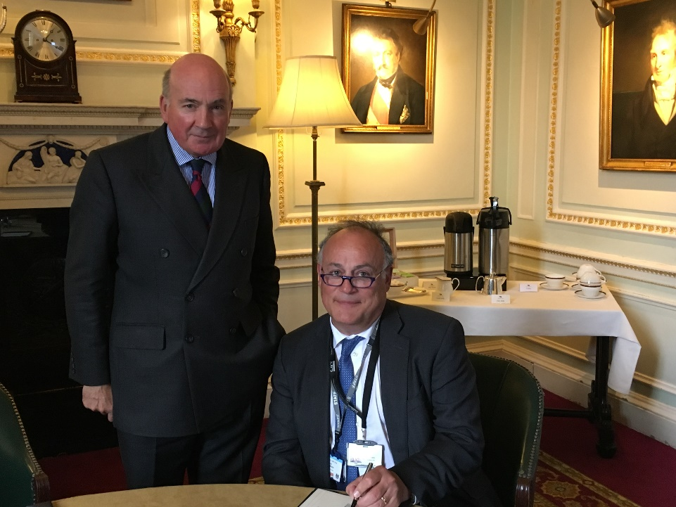
VCHA Patron General the Lord Dannatt GCB CBE MC DL
Professional Head of the British Army 2006 – 2009;
40 years' service; formed Help for Heroes charity.

Slide 6
The Alliance’s purpose
“The aim is to develop, share and drive the implementation of best practice that will improve armed forces veterans’ care, whilst at the same time also raising standards across the NHS for all users.”
- Veterans Covenant Healthcare Alliance Terms of Reference
The Veterans Covenant Healthcare Alliance provides a mechanism for a group of volunteer trusts to identify and showcase the best standards of care for Armed Forces veterans, in line with commitments set out in the Armed Forces Covenant.

Slide 7
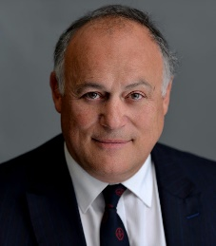
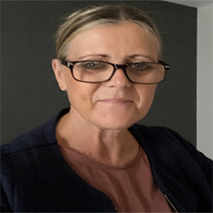
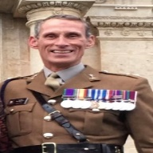
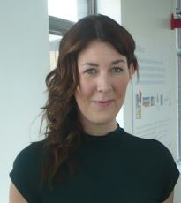
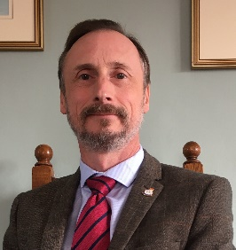
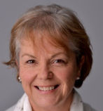
VCHA/Rehab Team (as at 4 May 2022)
Professor Tim Briggs CBE
Chair and National Lead VCHA
Kate Davies CBE
Armed Forces Directorate
Guy Benson
Team Lead
Lynsey Nicholson
North East and West
David Wood
Midlands and East of England
Anna-Marie Tipping
London
Bernadette Knight
South East and West
Maisy Provan
Rehab Team
Notes:
Allison

Slide 8
VCHA Manifesto
The Trust understands and is compliant with the Armed Forces Covenant
2. The Trusts has a clearly designated Veterans’ Champion Dyad
3. The Trust supports the UK Armed Forces as an employer
4. The Trust has established links to appropriate nearby veteran services
5. Staff at the Trust are trained and educated in the needs of veterans
6. The Trust raises awareness of veterans
7. The Trust identifies veterans to ensure they receive appropriate care
8. The Trust will refer veterans to other services as appropriate
1-Year Review 3-Year Re-accreditation

Slide 9
Common Operating Picture
Region | Accredited | Progress 1 | Progress 2 | Not Started | Reviewing | Trusts
EoE | 12 | 4 | 5 | 1 | 6 | 22
London | 7 | 7 | 13 | 8 | 0 | 35
Midlands | 18 | 15 | 4 | 0 | 7 | 37
NENCY | 19 | 5 | 6 | 2 | 0 | 33
NW | 20 | 3 | 4 | 5 | 0 | 32
SE | 15 | 7 | 6 | 1 | 4 | 29
SW | 18 | 0 | 2 | 0 | 1 | 21
Dev | 2 | 0 | 0 | 0 | 0 | 2
Pilots | 1 | 8 | TBC | TBC | TBC | TBC
Total | 111 | 44 | 40 | 17 | 18 | 211
% | 53% | 19% | 18% | 8% | 8% | 100%

Slide 10
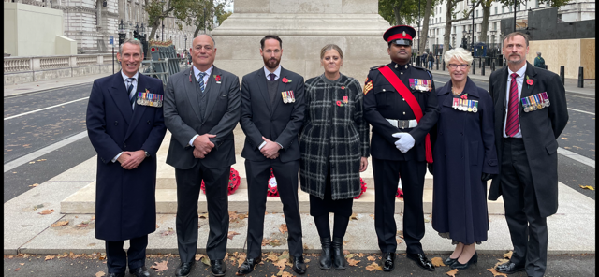
Questions

